Slide 1
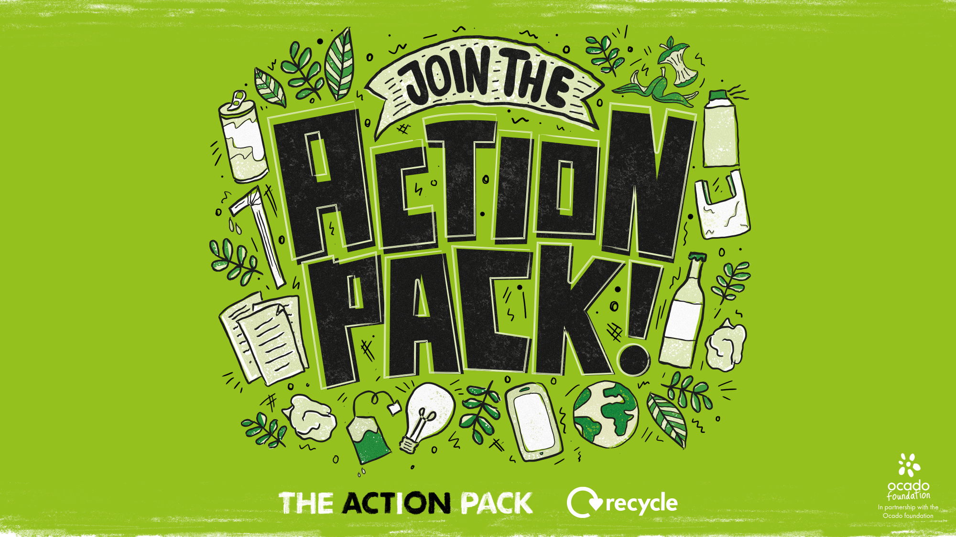

Slide 2
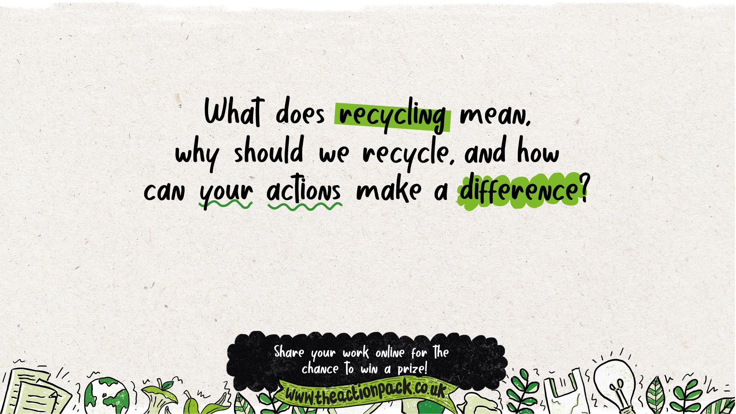
Curriculum links: PSHE, Science
Time required: 30 minutes for core content, plus optional extension activities

Slide 3
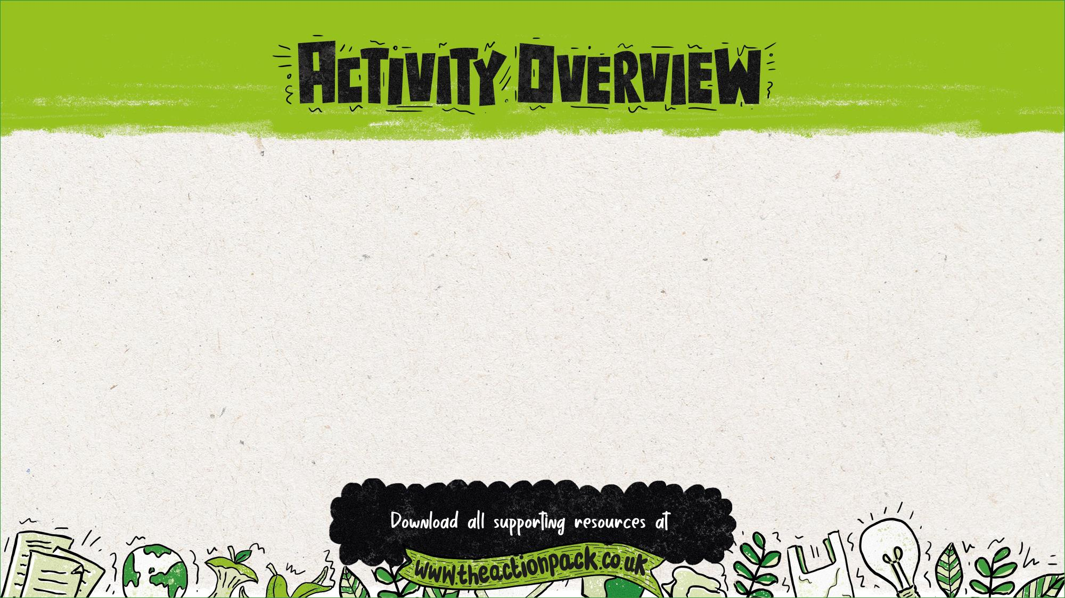
This presentation explores recycling, including why people should recycle, what can be recycled and proper recycling techniques. It also explores what it means to be an active citizen and encourages pupils to spread the word about what they have learned.
Where to use this activity
This presentation can be used:
in class
at after-school clubs
with an eco committee or school council
in an out-of-school club.
How to use this presentation
The teachers’ notes slides at the start of this presentation, including this slide, are hidden so that they won’t appear in presentation mode.
There is additional information for teachers in the slide notes for each of the pupil slides (6-27).
Preparation
Optional: Ask students to bring in a range of recyclable materials.
Optional: Send home the: Home recycling survey activity sheet as a home-based pre-task.
Optional: Order the free resource pack through the Action Pack website, or print out the Recycling In Our Area poster template.
Follow up
Optional: Send home a Recycling homework sheet (versions for Years 3/4 and Years 5/6)
Optional: Submit your work online to be in with a chance of winning some eco prizes

Slide 4
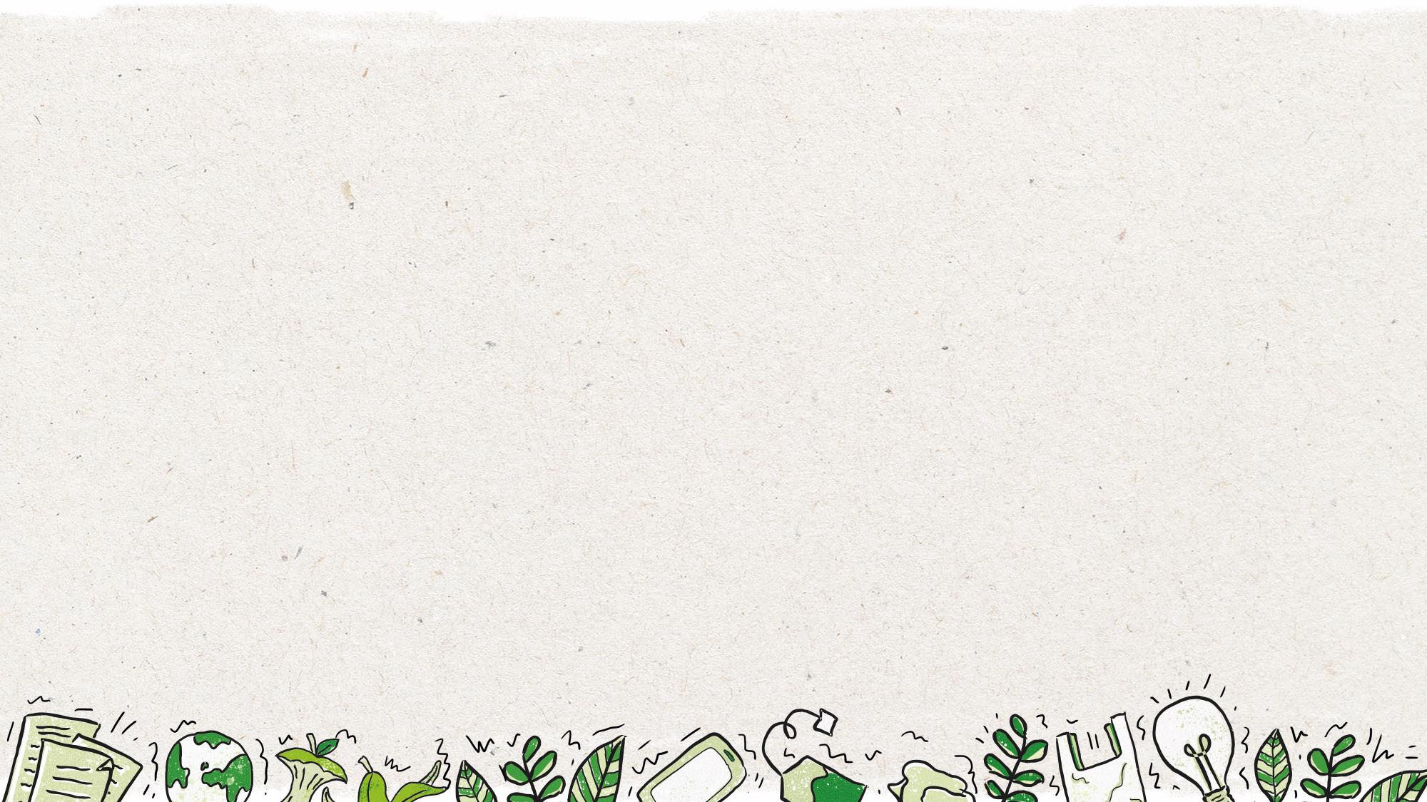
Why use this activity?
This lesson was created in partnership with teachers to make sure that it links to the curriculum and enhances learning.
The lesson helps to inform, inspire and empower children to get their voice heard and bring about change.
It also encourages pupils to become active citizens who make a positive contribution to society, helping to fulfil the requirements of Ofsted and promote British values.
This PowerPoint could form part of your audit and action plan for the UNICEF Rights Respecting Schools Award, or as part of your Eco-Schools Award action plan.
It includes flexible resources that can be used with small groups, a whole class, the entire school or the School Council.
Use this lesson to get people in your local area recycling more, helping to conserve our planet’s precious resources.
By submitting the work your pupils produce in this lesson, you’ll be in with a chance to win great prizes.
Who produced this activity?
Recycle Now is an established brand that campaigns to encourage and motivate citizens to recycle more things, more often, from all around the home. We use our evidence, interventions and ground-breaking behaviour change theory to motivate citizens to recycle.
For more information about Recycle Now visit: www.recyclenow.com
You can also help to encourage recycling by adding the Recycling Locator to your website – email: partnerenquiries@wrap.org.uk

Slide 5
PSHE Association Programme of Study, England
Core Theme 3: Living in the wider world
KS2
L1. to research, discuss and debate topical issues, problems and events that are of concern to them and offer their recommendations to appropriate people
L7. that they have different kinds of responsibilities, rights and duties at home, at school, in the community and towards the environment; to continue to develop the skills to exercise these responsibilities
L10. to recognise the role of voluntary, community and pressure groups, especially in relation to health and wellbeing
L15. that resources can be allocated in different ways and that these economic choices affect individuals, communities and the sustainability of the environment across the world
Northern Ireland, Key Stage 2
The World Around Us
pupils should be enabled to explore how waste can be reduced, reused or recycled and how this can be beneficial.
Science, Year 4
Living things and their habitats
recognise that environments can change and that this can sometimes pose dangers to living things.
(Pupils should explore examples of human impact (both positive and negative) on environments, for example, the positive effects of nature reserves, ecologically planned parks, or garden ponds, and the negative effects of population and development, litter or deforestation)
Ofsted School inspection handbook
'Pupils' spiritual, moral, social and cultural development (SMSC) equips them to be thoughtful, caring and active citizens in school and in wider society.’
Promoting fundamental British values as part of SMSC in schools
'Through their provision of SMSC, schools should… encourage students to accept responsibility for their behaviour, show initiative, and to understand how they can contribute positively to the lives of those living and working in the locality of the school and to society more widely.’
Unicef Level 1 Rights Respecting Schools Award
'Children and young people are beginning to see themselves as rights respecting global citizens and advocates for fairness and children’s rights locally and globally.’

Slide 6
Notes:
Delivery notes
As a warm up activity, ask your pupils to suggest some answers to the questions on screen.
After they have suggested some answers, ask them to think about who they were talking about in their answers. They might realise that they only discussed adults in their answers, or they might be confused by the question. Either way, move onto the next slide to discuss what children can do to make the world a better place.

Slide 7
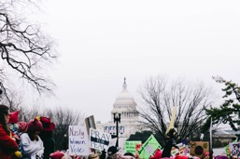
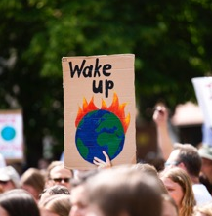
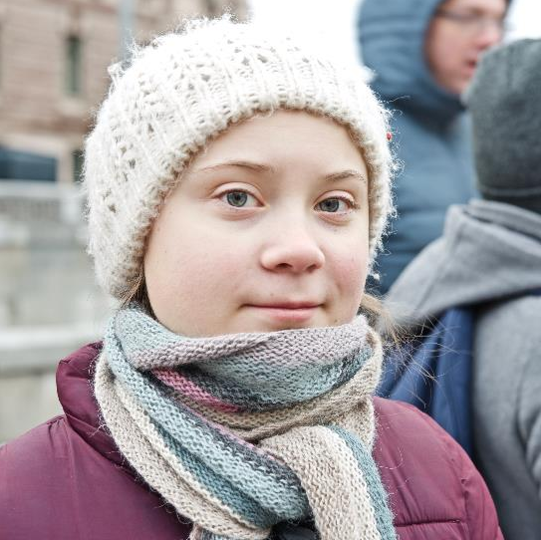
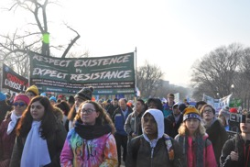
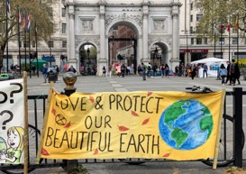
Notes:
Delivery notes
Discussion – How can children make the world a better place? (2 minutes)
Ask pupils:
What can children do to make the world a better place?
After discussion, click to reveal the images of Greta Thunberg and the School Strike that she inspired.
Do pupils know who and what these pictures show?
Explain that Greta Thunberg started protesting outside a government building in Sweden at age 15, saying that immediate action was needed to protect the environment. Soon after, she was speaking in front of world leaders. Her actions lead to the school protests that spread across the world in 2018-19.
In May 2019, over 1 million students in 1,400 cities around the world took to the streets to promote protecting the environment. The purpose of this march was to spread their message and get their voices heard.
If time allows, complete one or both of these optional extension activities:
OPTIONAL EXTENSION 1:
Debate – How should schools respond to the school strikes? (10 minutes)
Thinking about the school strikes, ask students to stand up to vote on the right approach for schools and teachers to take in response to Greta’s school strikes:
Actively support young people in taking part, e.g. by helping them to make signs, hiring transport to take them to the march
Punish young people who miss school to take part
Neither – allow them to take part if they wish, but don’t encourage them or punish them
Ask representatives from each group to explain their thinking, then ask students to vote again. Has anyone changed their mind?
OPTIONAL EXTENSION 2:
Research – How are young people making a difference? 20 minutes
Ask pupils to research a young person who is an active citizen – who has spoken up and made a difference, effecting change at a local, national or global level.
Emphasise that any impact, no matter how big or small, is significant and important.
After 10 minutes, bring students back together and ask them to share what they’ve learnt, or ask them to create a fact file or poster.
Pupils could investigate on of these young people, who have taken action on environmental issues :
Elizabeth Farrell www.vam.ac.uk/articles/glacier-girl – Elizabeth, also known as Glacier Girl, was 19 when she produced an art exhibition promoting environmentalism that has been on exhibit at London’s V&A Museum.
Ryan Hickman http://ryansrecycling.com – Ryan has made recycling his life’s mission. He’s set up his own charity, organised recycling events all over America, been on national television and helped to recycle over half a million cans and bottles – all before the age of 10!
Xiuhtezcatl Martinez www.earthguardians.org/xiuhtezcatl – Xiuhtezcatl (pronounced "shoo-tez-cat“) is a Youth Director at Earth Guardians, a global environmentalist organisation, and gave a TED talk at the age of 15. He is currently fighting the United States government in a legal battle, claiming that they have failed to act on climate change.
Melati and Isabel www.byebyeplasticbags.org – Teenage sisters Melati and Isabel are fighting to bring an end to single-use plastic bags. They set up Bye Bye Plastic Bags at the ages of 10 and 12, bringing together young people to halt the use of plastic bags and protect the environment in Bali, Indonesia, where they live.
Children aren’t the only ones making a difference! These dogs have been doing their bit to help our plant
www.guinnessworldrecords.com/world-records/93947-most-bottles-recycled-by-a-dog
www.youtube.com/watch?v=pXY8NLamZks

Slide 8
To understand why recycling is important
To understand what can be recycled in your school, home and local area, and which bins to use
To understand why it’s important to take action and spread the word about recycling
I can…
…explain what recycling is, and why it is important
…use the recycling locator to check what can be recycled in your area
…help others to recycle by explaining what you have learnt
Notes:
Delivery notes:
Discussion - Learning aims and success criteria (2 minutes)
Run through the learning objectives and success criteria with your students.

Slide 9
Notes:
Delivery notes:
Join the Action Pack film (5 minutes)
After playing the film to the class, discuss these questions in pairs or as a class:
How did this film make you feel?
What do you think is the message of this film? Does it have more than one message?
Does this film make you want to take action? Why?
Did this film teach you anything?

Slide 10
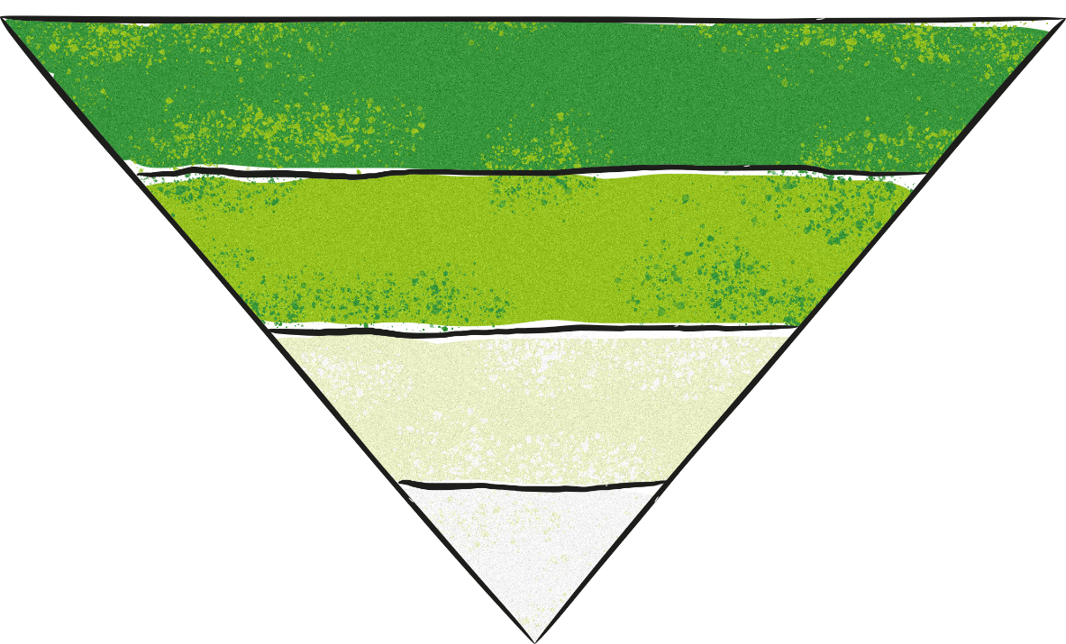
Notes:
Delivery notes:
Discussion and sorting activity – What is recycling? (3 minutes)
Ask pupils:
What is recycling? Create a definition as a class, e.g. Recycling means to process something (like paper, glass or metal) so that it can be used again.
What are the alternatives to recycling our waste? Pupils may think about reducing what we use – not using it in the first place, reusing it, or disposing of it in landfill?
Click to display the blank triangle and the words Reduce, Reuse, Recycle and Dispose. Explain that we’re going to put the best option at the top, and the worst option at the bottom of the triangle.
What order should these words be placed in?
Click to display the hierarchy of waste, which shows how we should reduce waste and our impact on the environment:
Firstly, we should reduce our use of materials, especially common waste products like plastics. For example, we could take a re-usable water bottle out with us, so we don’t need to buy a single-use plastic bottle.
Secondly, we should reuse any materials that we can, for example by using newspapers as packing paper.
Finally, when we can no longer reuse an item or material, we should recycle it, so that it can be made into more products.
So you should only buy things you really need, and once you’re finished with them they should only be put in the bin and sent to landfill if it isn’t possible to reuse or recycle them.

Slide 11
It takes less energy to make things with recycled materials
It saves energy and natural resources
It uses up natural resources that we don’t need
It means more rubbish is put into landfills
It protects natural environments and wildlife
It reduces carbon emissions, helping to stop climate change
Notes:
Delivery notes:
Sorting activity: Why do we recycle? (5 minutes)
Go down the list of reasons and ask pupils to choose whether they are true or false. Assign one side of the room as ‘True’ and the opposite side as ‘False’ and ask pupils to move to each wall to choose their answer. Alternative, pupils could raise their hand to indicate that they believe a reason is true.
Click the screen to make the statements move to the correct side of the screen one by one.
The top three reasons we should recycle, explained:
It saves energy and natural resources
Recycling an item and using it to make something new takes less energy than if we were to make that item from scratch. This means that recycling saves energy, which can then be used to do other things. Also, if we recycle, we use less of our natural resources (metal, trees for paper, oil for plastic, sand for glass, cotton for fabric). For example, by recycling metal cans we provide metal that can be used to make new items, meaning that we don’t have to mine more metal from the ground.
It reduces the amount of rubbish put into landfills
When something is thrown away in normal bins, it’s often taken to a special location and buried underground. These places are called landfills, and they are very bad for the environment. Rubbish in landfills slowly breaks down into harmful gases and chemicals. These gases and chemicals can pollute soil and add extra greenhouse gases into our atmosphere, leading to climate change. By recycling, we reduce the amount of rubbish going into landfills, helping to protect the environment and reduce climate change.
It protects natural environments and wildlife (and combats climate change)
As recycling reduces the amount of energy needed to produce new products and lessens the amount of greenhouse gases in the atmosphere by minimising the rubbish put in landfills, recycling does a lot to help combat climate change. Climate change, explained briefly, is the gradual warming of the planet caused by human energy use and poor waste management. Climate change is destroying animal habitats, causing extreme weather conditions and putting strain on animals and humans alike. By recycling, each of us can help to protect our planet and combat climate change.

Slide 12
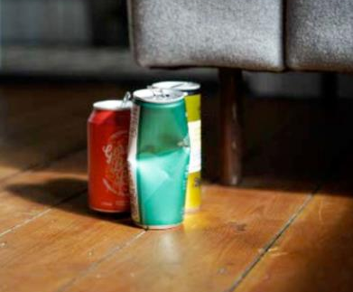
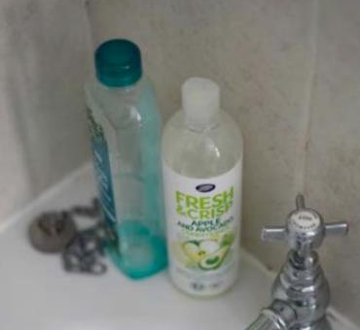
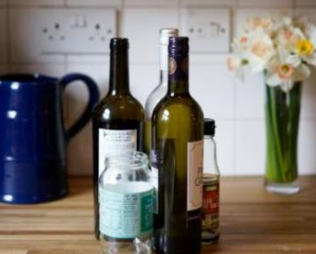
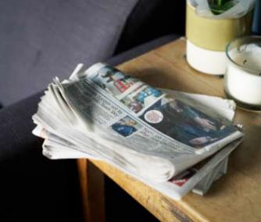
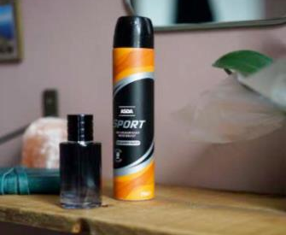
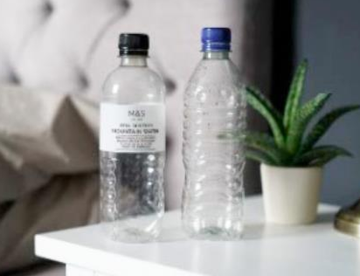
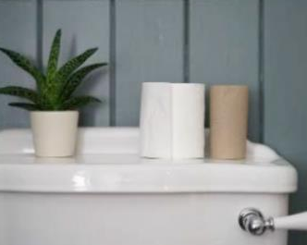
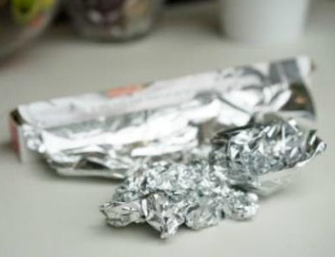
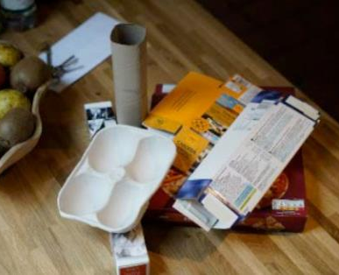
Notes:
Delivery notes
Discussion: What materials are commonly recyclable? (3 minutes)
Ask pupils:
What can we recycle? Take 5 or 6 suggestions from the class.
Click on the screen to reveal items that can commonly be recycled (all areas are a bit different).
If your class come up with any suggestions not shown on the slide, check on the Recycle Now website to see if they are in fact commonly recyclable. www.recyclenow.com/recycling-knowledge/recycling-around-your-home

Slide 13
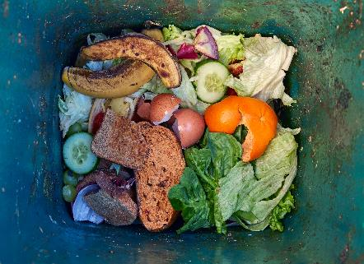
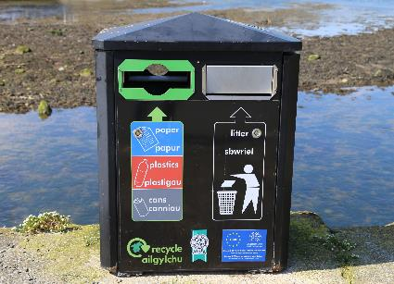
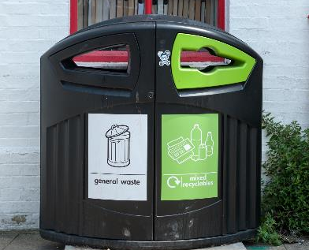
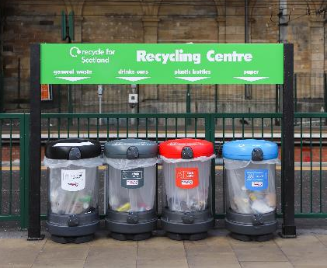
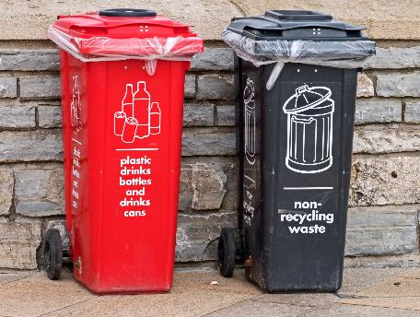
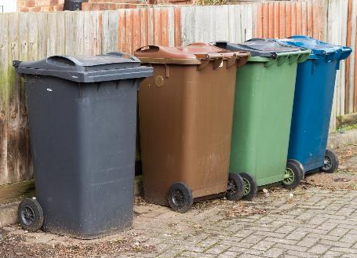
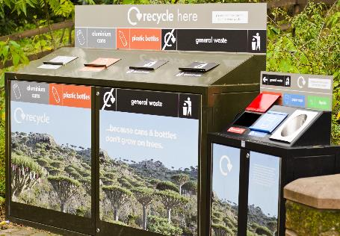
Notes:
Delivery notes
If time allows, replace these images with images of a recycling bins from your own home (or images from the Recycling Locator for your area) and school.
Discussion activity – Where do we recycle? (5 minutes)
Ask pupils:
What recycling containers do you have at home? What goes into them? Refer to the Home recycling survey, if you set this as a pre-task – what recycling containers do pupils have at home?
Where are the recycling bins in school? What do they look like? What goes in them?
Is there anywhere else that they can recycle in their area? (For example large recycling bins in supermarket carparks, or facilities at council recycling centres.)
Explain how important it is to know what can be recycled in your area and what bins to use, as this is the only way that you can recycle effectively.
Internet-based research: What can we recycle in our area? (7 minutes)
Use Recycle Now’s Recycling Locator - www.recyclenow.com/local-recycling to identify what recycling containers are used in your area, and what can be put in each.
Ask pupils:
Are you surprised by anything they learn using the Recycling Locator?
EXTENSION ACTIVITY 1:
Make a ‘Guide to recycling in our area’ poster (15 minutes)
You record your findings from using the Recycling Locator on the Recycling In Our Area poster. Cut out the recycling containers, colour them in, and stick them to the template poster, then annotate them to show what goes into each container.
A printed copy of the poster and the recycling container sheet is included in the starter pack, or you can print off the materials at www.theactionpack.co.uk
Display your personalised poster in a location where parents and school staff will be able to see it.
EXTENSION ACTIVITY 2:
Sorting task (10 minutes)
Complete an in-class sorting activity using the information learned from using the Recycling Locator.
Split pupils into four groups of 2-5 and give each group a selection of recyclable and non-recyclable items. Ask them to sort the items into two piles: items recyclable in your area and items not recyclable in your area.
Ask groups to review each others work after 3 minutes, using Recycle Now’s recycling locator to check specific items. Pupils could take a photo at the end of the activity and display it in the classroom as a reminder of the materials that can/can’t be recycled in their area.
NB: For more activities and examples related to recycling bins, download the Recycling Homework Sheet from www.theactionpack.co.uk

Slide 14
Not recyclable
Sometimes not recyclable
Bubble wrap
Ceramics
Laminated paper
Wood
Mirrors
Paper with metallic, glitter or velvet on it
Toxic containers (items that could usually be recycled, like metal cans, can’t be recycled if they were used to hold toxic materials, such as paint)
Greasy containers (like toxic containers, recyclable items that have grease on them usually aren’t recyclable)
Stickers
Sellotape
Plastic toys
Nappies
Pet food pouches
Cat litter
Toothpaste tubes
Cotton wool
Tissues
Bricks
Pots, tubs and trays– so make sure to check if they can be recycled in your area using the Recycling Locator
Some wrapping materials aren’t recyclable – use the scrunch test to check
Check the recycling locator
Plastic wrapping and bags (sometimes called soft plastic) can often only be recycled at supermarkets. Check the recycling locator to see if this can be recycled in your local area.
Electronic items - these can be recycled, but they usually need to be recycled separately at a recycling centre. Some local authorities do collect them from your kerbside collection so check the recycling locator to see if they can be recycled in your local area.
Notes:
Delivery notes
What can’t be recycled (2 minutes)
Run through the list so that pupils understand what is not recyclable. This slide can also be printed out and used as a reference in the classroom, around the school or in pupils’ homes.

Slide 15
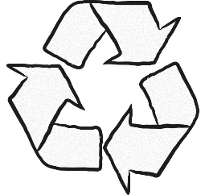
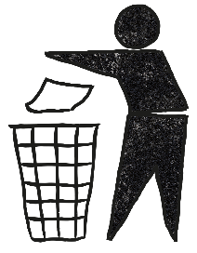
Check locally
This symbol is put on items that can only be recycled in some parts of the UK. It is up to you to check whether it can be recycled in your area.
Not yet recycled
This symbol is put on items that aren’t recycled in most parts of the UK yet.
The Mobius Symbol
This symbol is used on items that are made of a recyclable material. However, it doesn’t say anything about whether the material is recyclable in your area.
Widely recycled
This symbol is put on items that are recycled in most parts of the UK. However, it’s still a good idea to check whether the items are recyclable in your area.
The Green Dot
This symbol is used by companies who have paid money to help with recycling efforts in Europe, but it doesn’t mean the item is recyclable.
Tidyman
This symbol is part of a campaign called Keep Britain Tidy. It is used to encourage people to throw rubbish away instead of littering, but doesn’t relate to recycling.
Notes:
Delivery notes
Symbol identification activity: How do you know if something can be recycled? (5 minutes)
Reinforce that not all materials, or types of a material (e.g. types of plastic) can be recycled. Ask pupils:
How do you know if something can be recycled? Explain that many materials have symbols to give you information about recycling.
On screen are a number of recycling-related symbols. Ask pupils:
Do they recognise any of the symbols? What do they mean?
Explain that many people don’t know what these symbols actually mean. To check what the symbols on the screen mean, click to reveal their definitions. Ask students to suggest what each symbol might mean before revealing them.
Check out Recycle Now’s comprehensive guide to recycling symbols here: www.recyclenow.com/recycling-knowledge/packaging-symbols-explained

Slide 16
Notes:
Delivery notes
EXTENSION ACTIVITY
Creative activity: Create Recycling Reminder signs for your home (20 minutes)
Ask pupils to think about the different materials that can be recycled in each room of their house.
Explain that they need to create recycling reminder signs to stick up in each room of their house.
They could create a sign for the kitchen, bathroom, bedroom or living room.
Play this video to give pupils an idea of what items can be recycled from each room: www.youtube.com/watch?v=sLktjtlXCNo
Encourage pupils to think of more recyclable items that are in different rooms in their own homes.
NB: For more activities and examples related to room-by-room recycling, download the Recycling Homework Sheet from www.theactionpack.co.uk
Then, they can tell their family about all the things they’ve learnt today and put up their Recycling Reminder signs in their home!

Slide 17
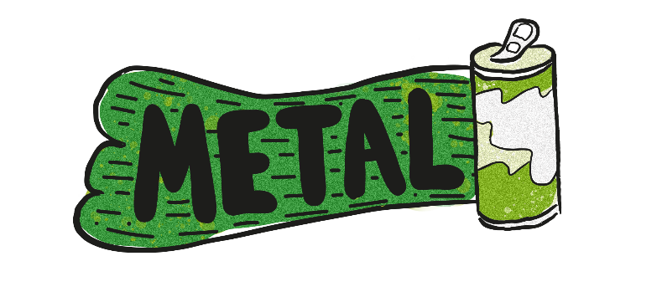
Notes:
Delivery notes
OPTIONAL EXTENSION:
How do you recycle glass, paper and plastic? (10 minutes)
Explain that all the different materials that can be recycled need to be processed in different ways. So, how are different materials recycled?
Ask pupils to pick one of the materials on the board.
Click the name of the material to be taken to the relevant slide in the PowerPoint.
After learning about how each material is recycled, you’ll get to choose whether you continue with the presentation or come back to this page to choose another material.

Slide 18
Notes:
Delivery notes
OPTIONAL ACTIVITY:
How do you recycle glass?
Explain to your pupils that they need to pay attention to the film as you’ll be asking them questions after watching the video.
After watching the film, ask the children the following questions:
What percentage of glass is recycled in the UK? 60%
How is the glass sorted before it is recycled? By colour
At what temperature is the cullet melted? Over 1500°C

Slide 19
Once glass is collected and taken to be reprocessed, it is:
crushed and has any contaminants removed (such as labels or bits of food)
sorted by colour
mixed with other materials, depending on how the new glass will be used
melted in a furnace
moulded or blown into new bottles or jars

Slide 20
Notes:
Delivery notes
OPTIONAL ACTIVITY:
How do you recycle paper?
Explain to your pupils that they need to pay attention to the film as you’ll be asking them questions after watching the video.
After watching the film, ask the children the following questions:
How much paper does the UK use each year? 12 million tonnes
How is the paper pulp cleaned? By being spun in a cone-shaped container
Can you name two things that need to be removed from paper before it can be recycled? Paper clips and labels

Slide 21
Once paper is collected and taken to be reprocessed, it is:
sorted by colour and quality
pulped in a tank containing water and chemicals
screened to filter out debris and other objects, like paper clips
cleaned and coloured, if required
sprayed onto a mesh to form a sheet
pressed, heated and dried using rollers
stored in rolls until they are ready to be used

Slide 22
Notes:
Delivery notes
OPTIONAL ACTIVITY:
How do you recycle plastic?
Explain to your pupils that they need to pay attention to the film as you’ll be asking them questions after watching the video.
After watching the film, ask the children the following questions:
Plastics are sorted by colour. How many colour groups are there? Four – blue, natural, green and mixed
Before recycled plastic is made into new products, what is it formed into? Pellets

Slide 23
Once plastic items are collected and taken to be reprocessed, they are:
sorted from other recyclable materials
cleaned and sorted by plastic type using advanced technology
then sorted by colour: blue, natural, green and mixed
shredded, washed, melted and reformed into pellets; these pellets can then be used to make new plastic items, from clothes and furniture to more bottles and containers

Slide 24
Notes:
Delivery notes
OPTIONAL ACTIVITY:
How do you recycle food?
Explain to your pupils that they need to pay attention to the film as you’ll be asking them questions after watching the video.
After watching the film, ask the children the following questions:
When food waste is taken to landfill sites, it rots and release which gas into the environment? Methane
When composting food, what temperature do the containers go up to? 70°C
What energy product can be produced from recycling food? Biogas

Slide 25
Once food is collected, it is recycled in one of two ways:
In-vessel composting
involves mixing food waste with garden waste
it is then shredded and composted in an enclosed system for around 2-4 weeks
temperatures of up to 70°C speed up the process and ensure any harmful microbes are killed off
it is then left outside to mature for a further 1-3 months before going on to be used as soil conditioner
2. Anaerobic Digestion
uses microorganisms to break down food waste inside an enclosed system
as the food breaks down it gives off methane, which is collected and converted into biogas
the biogas is used to generate electricity, heat and fuel
it also creates a nutrient-rich fertiliser for agriculture and in land regeneration

Slide 26
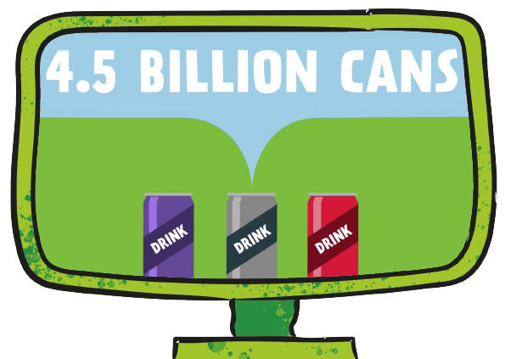
Notes:
Delivery notes
OPTIONAL ACTIVITY:
How do you recycle metal?
Explain to your pupils that they need to pay attention to the film as you’ll be asking them questions after watching the video.
After watching the film, ask the children the following questions:
How many aluminium cans were recycled in the UK last year? 4.5 billion cans
What temperature are aluminium blocks heated to? Over 750°C
How long does the metal recycling process take, from an old can to a new can? 8 weeks

Slide 27
Once metal is collected and taken to be reprocessed, it is:
sorted from other recyclable materials
sorted by metal type using magnets
formed into blocks and shredded into small pieces
heated to remove decoration
melted in a furnace, poured into moulds and cooled
rolled into thin sheets, ready to be used again

Slide 28
Just a nudge!
Some councils encourage recycling by giving households a big recycling bin and smaller rubbish bin. A simple nudge to recycle more!
Spark a change!
To recycle more and better people need to know how to recycle well, have the time and chance to change and a spark to inspire them to get started. What will your script provide?
Follow the crowd!
Some people are more likely to recycle when they know that others are really passionate about recycling and are recycling on a regular basis!
Notes:
Delivery notes
(Optional discussion) Older/more able students may find it useful to further consider examples of how people aim to change behaviour before starting to create their scripts. Discuss how pupils could use these ideas/theories of behaviour change in their scripts e.g. suggesting that people make their recycling bin easier to access than their waste bin, asking people to ‘join the recycling movement’, adding statistics about how many people already recycle, or providing information about how easy it is to recycle and how we can all improve our recycling.
Further information
Nudge theory: this theory of behaviour change focuses on creating small ‘nudges’ or opportunities for people to change their behaviour. Other examples include an American Grocery store which placed green arrows on the floor of its shops leading to the grocery isles, a simple addition led to huge increases in vegetable sales, or Amsterdam Airport where small fly stickers were added to urinals, having something to aim for (if only subconsciously) reduced ‘spillages’ by 80%!
The COM-B model of behaviour change highlights the importance of capability (knowledge, physical ability) opportunity (education, persuasion, time) and motivation (inspiration and the dedication to keep going).
Social norming: this theory of behaviour change assume people may be misinformed about key norms of behaviour (e.g. the number of people who smoke, or the amount of sugar the average person consumes) and therefore think it is fine for them to continue in habits that may be unhealthy/unhelpful. If people are informed about real social norms, they are more likely to make a change.

Slide 29
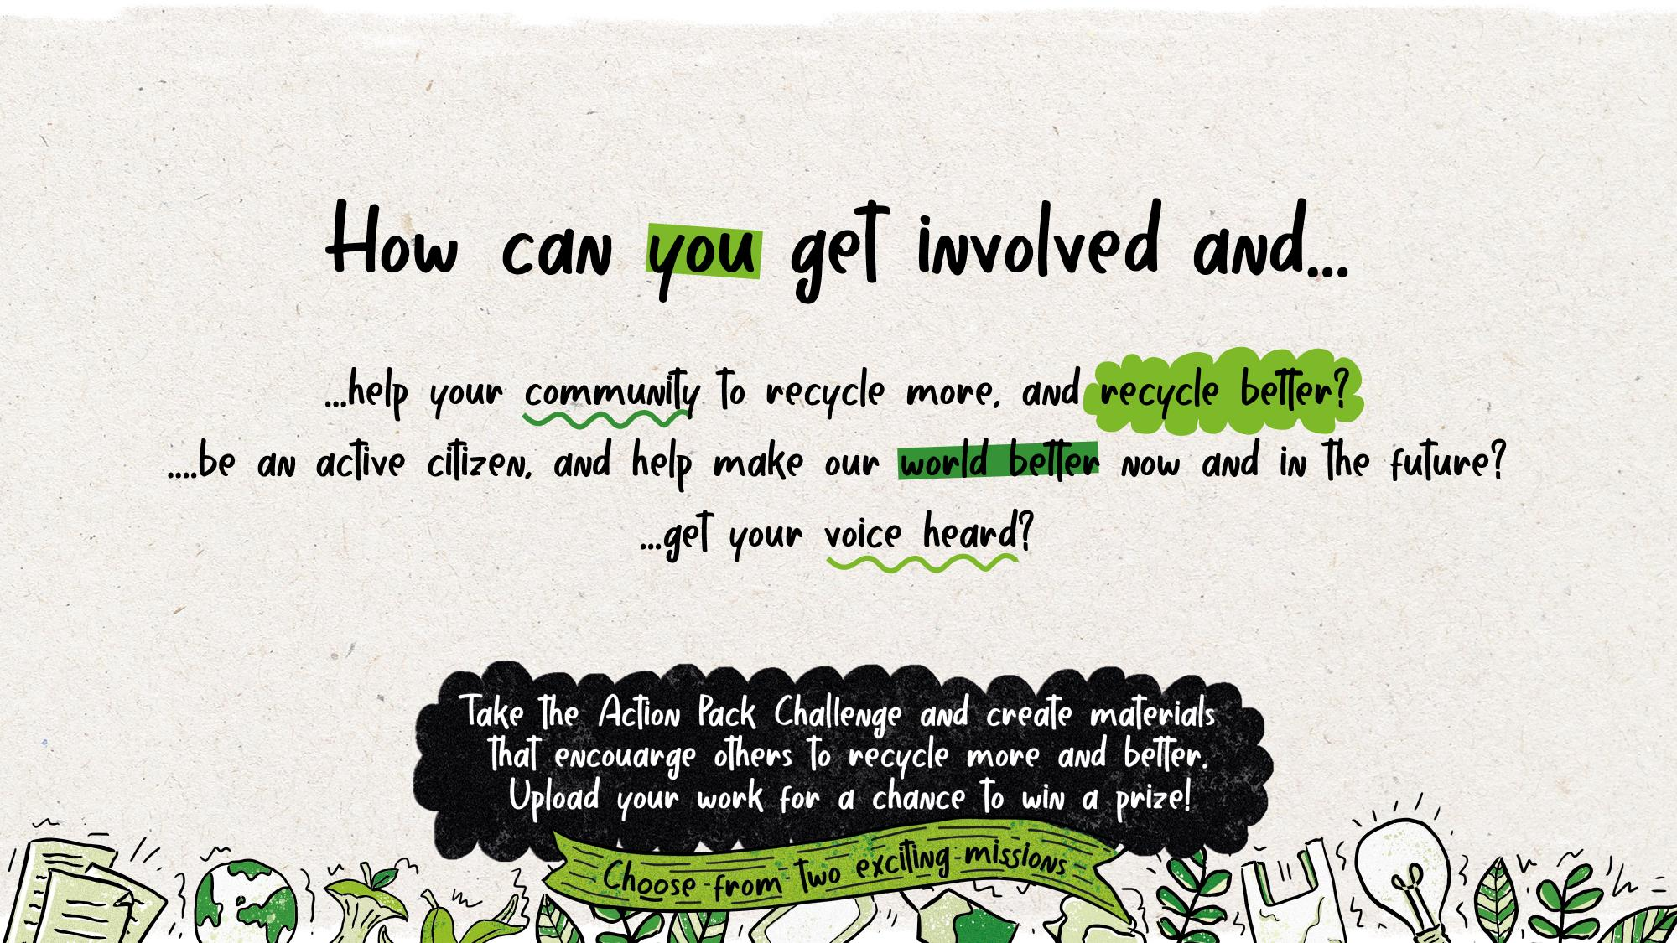
Notes:
Delivery notes
Discussion – Getting involved, making a difference (3 minutes)
Explain that the Action Pack is all about taking action and making positive changes! It’s not enough to simply learn about recycling, you need to use what you’ve learnt to make a difference!
Explain the three steps to taking action:
Using the information you’ve learnt to make positive changes in your own life and recycling as much as possible
Spreading the information you’ve learnt to other people in your life, such as your family, by talking to them about recycling and putting up the recycling posters you made around your house
Taking part in the Action Pack Recycling Challenge.
Plenary (2 minutes)
Before finishing the lesson, go over the learning aims with the class. Tell them to hold up fingers to show how well they think they completed each aim.
One finger = I don’t understand
Five fingers = I understand entirely
Learning aims:
To understand why recycling is important
To understand what can be recycled in your school, home and local area
To understand why it’s important to take action and spread the word about recycling
Use the same method to check whether pupils have completed all of the success criteria.
Success criteria:
Be able to explain what recycling is, and why it is important
Be confident using the recycling locator to check what can be recycled in different areas
To create recycling posters for your home and putting them up in places where they will be seen

