Slide 1


Slide 2
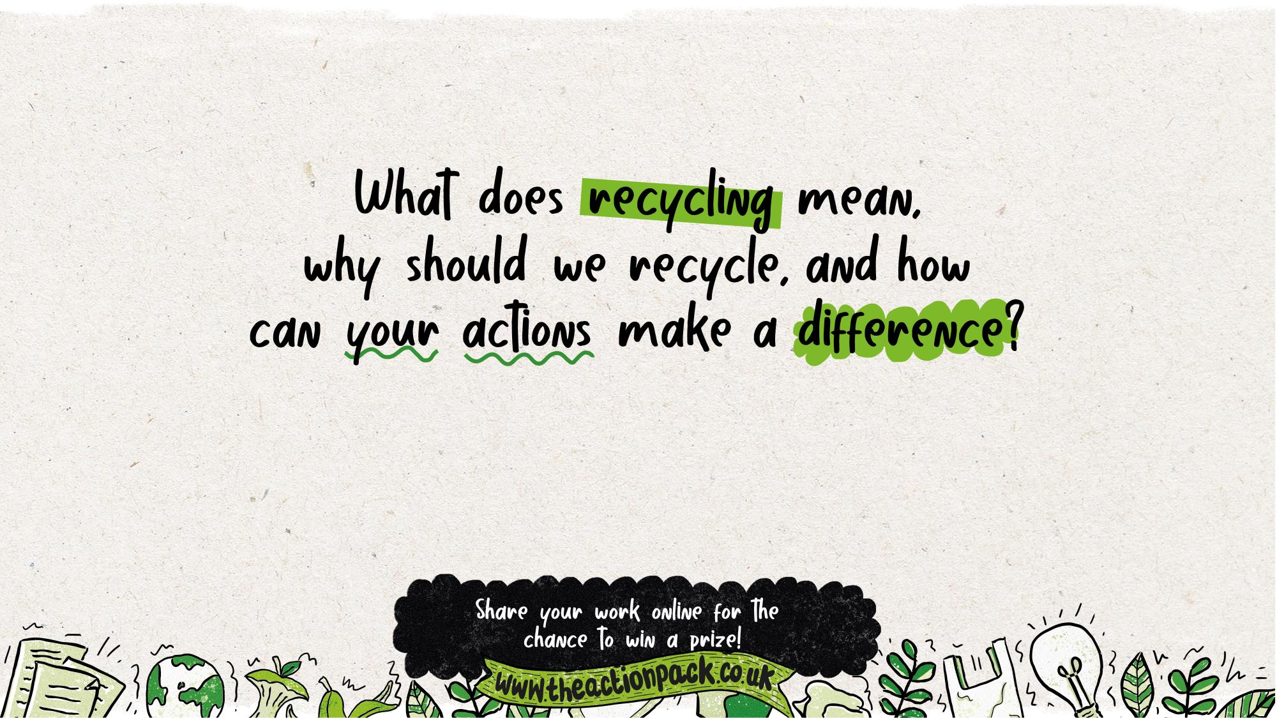
Curriculum links: PSHE, Science
Time required: 30 minutes for core content, plus optional extension activities

Slide 3
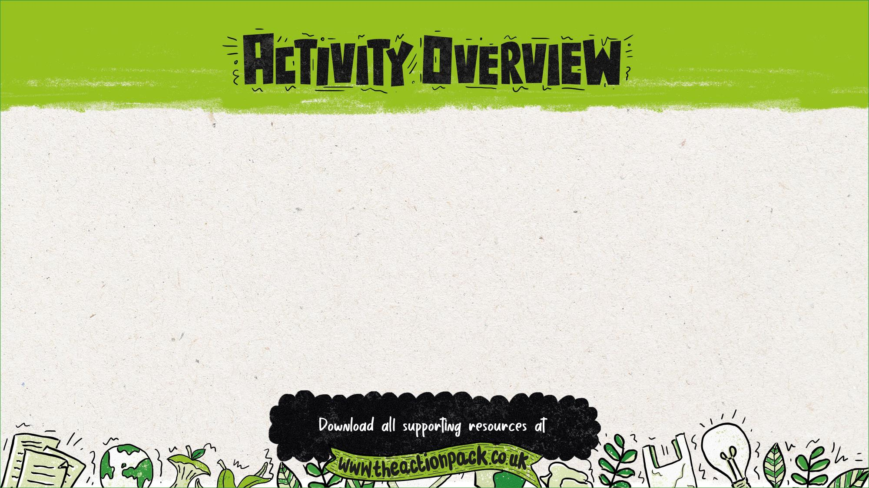
This presentation explores recycling, including why people should recycle, what can be
recycled and proper recycling techniques. It also explores what it means to be an active
citizen and encourages pupils to spread the word about what they have learned.
Where to use this activity
This presentation can be used:
in class
at after-school clubs
with an eco committee or school council
in an out-of-school club.
How to use this presentation
The teachers’ notes slides at the start of this presentation, including this slide, are hidden so that they won’t appear in presentation mode.
There is additional information for teachers in the slide notes for each of the pupil slides (6-27).
Preparation
Optional: Ask students to bring in a range of recyclable materials.
Optional: Send home the: Home recycling survey activity sheet as a home-based pre-task.
Optional: Order the free resource pack through the Action Pack website, or print out the Recycling In Our Area poster template.
Follow up
Optional: Send home a Recycling homework sheet
(versions for Reception and Years 1/2)
Optional: Submit your work online to be in with a chance of winning some eco prizes

Slide 4
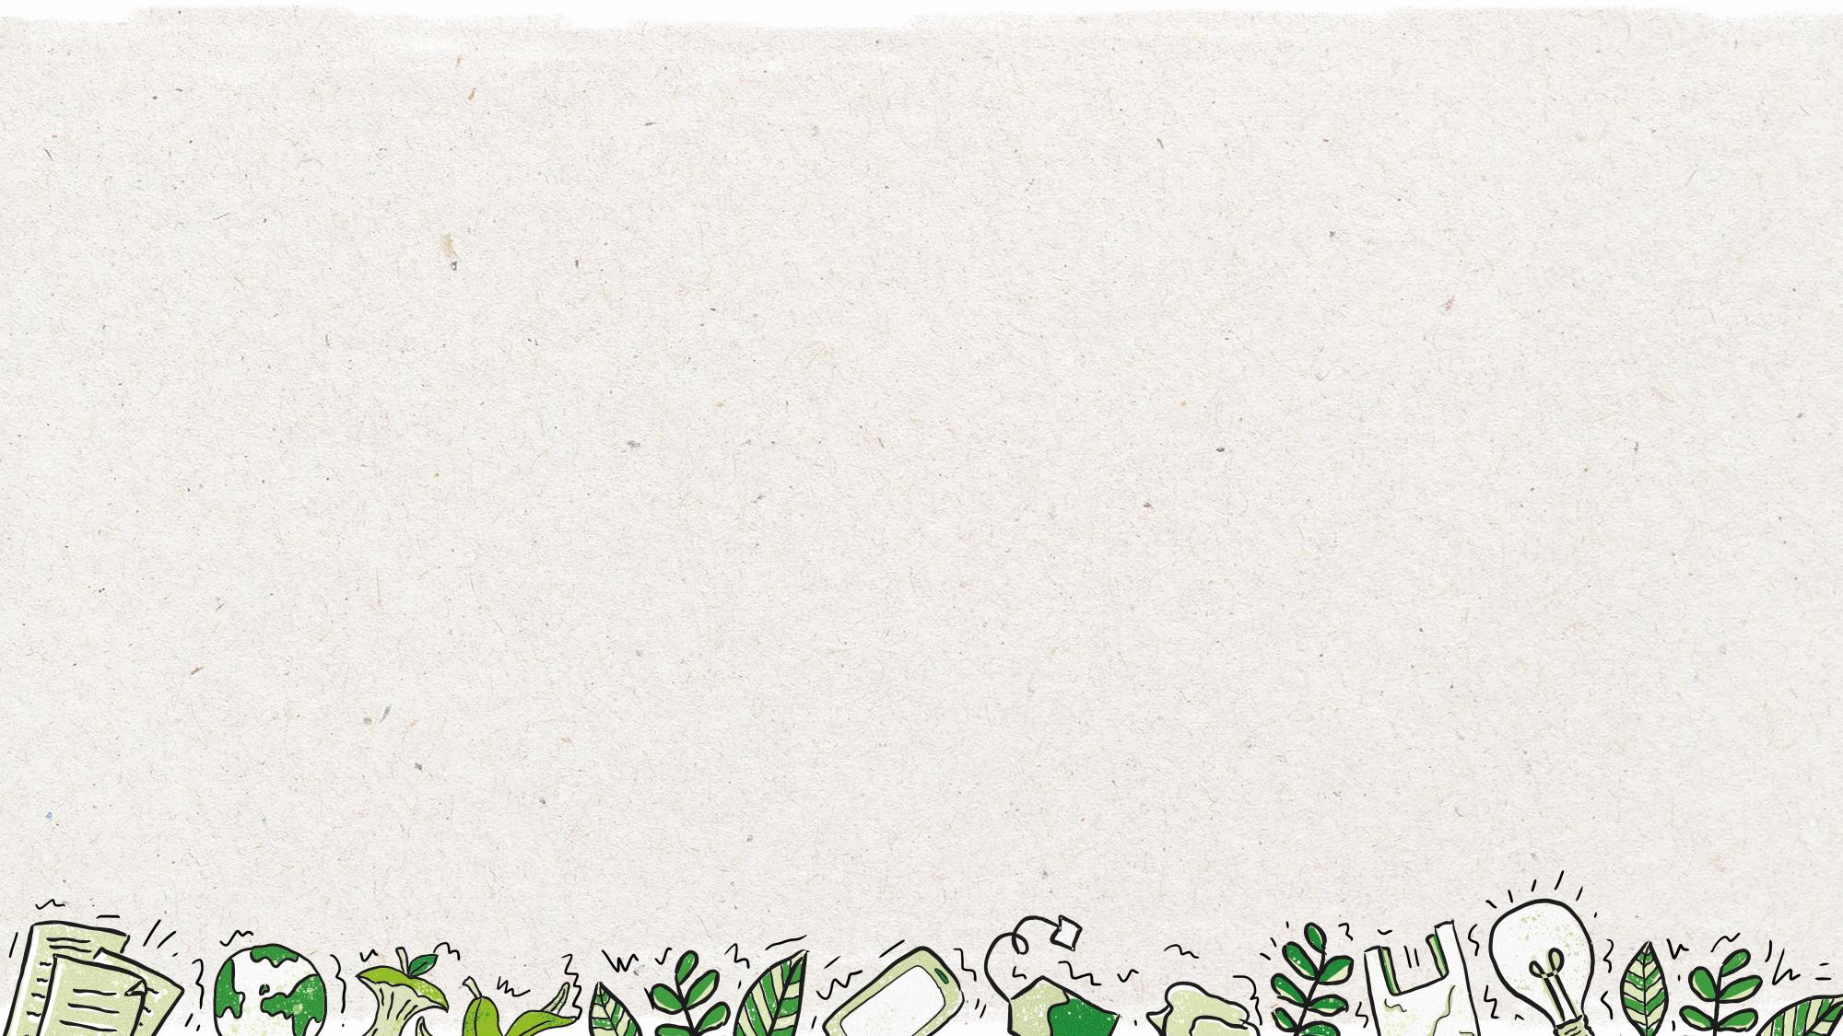


Why use this activity?
This lesson was created in partnership with teachers to make sure that it links to the curriculum and enhances learning.
The lesson helps to inform, inspire and empower children to get their voice heard and bring about change.
It also encourages pupils to become active citizens who make a positive contribution to society, helping to fulfil the requirements of Ofsted and promote British values.
This PowerPoint could form part of your audit and action plan for the UNICEF Rights Respecting Schools Award, or as part of your Eco-Schools Award action plan.
It includes flexible resources that can be used with small groups, a whole class, the entire school or the School Council.
Use this lesson to get people in your local area recycling more, helping to conserve our planet’s precious resources.
By submitting the work your pupils produce in this lesson, you’ll be in with a chance to win great prizes.
Who produced this activity?
Recycle Now is an established brand that campaigns to encourage and motivate citizens to recycle more things, more often, from all around the home. We use our evidence, interventions and ground-breaking behaviour change theory to motivate citizens to recycle.
For more information about Recycle Now visit: www.recyclenow.com
You can also help to encourage recycling by adding the Recycling Locator to your website – email: partnerenquiries@wrap.org.uk

Slide 5

PSHE Association Programme of Study, England
Core Theme 3: Living in the wider world
KS1
L5. what improves and harms their local, natural and built environments and develop strategies and skills needed to care for these (including conserving energy)
Northern Ireland, Foundation Years
The World Around Us
show curiosity about the living things, places, objects and materials in the environment
understand the need to respect and care for themselves, other people, plants, animals and the environment
Science, Year 1
Everyday materials
identify and name a variety of everyday materials, including wood, plastic, glass, metal, water, and rock.
(Pupils should explore, name, discuss and raise and answer questions about everyday materials so that they become familiar with the names of materials and properties such as: hard/soft; stretchy/stiff; shiny/dull; rough/smooth; bendy/not bendy; waterproof/not waterproof; absorbent/not absorbent; opaque/transparent.)
Science, Year 2
Uses of everyday materials
identify and compare the suitability of a variety of everyday materials, including wood, metal, plastic, glass, brick, rock, paper and cardboard for particular uses.
(Pupils should identify and discuss the uses of different everyday materials so that they become familiar with how some materials are used for more than one thing (metal can be used for coins, cans, cars and table legs; wood can be used for matches, floors, and telegraph poles) or different materials are used for the same thing (spoons can be made from plastic, wood, metal, but not normally from glass).)
Ofsted School inspection handbook
'Pupils' spiritual, moral, social and cultural development (SMSC) equips them to be thoughtful, caring and active citizens in school and in wider society.’
Promoting fundamental British values as part of SMSC in schools
'Through their provision of SMSC, schools should… encourage students to accept responsibility for their behaviour, show initiative, and to understand how they can contribute positively to the lives of those living and working in the locality of the school and to society more widely.’
Unicef Level 1 Rights Respecting Schools Award
'Children and young people are beginning to see themselves as rights respecting global citizens and advocates for fairness and children’s rights locally and globally.’

Slide 6

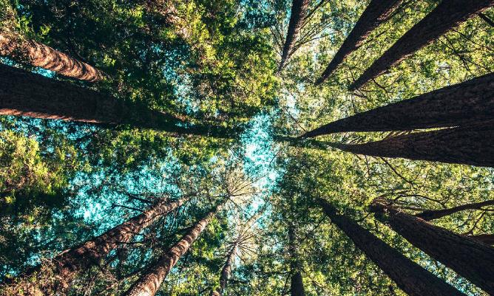
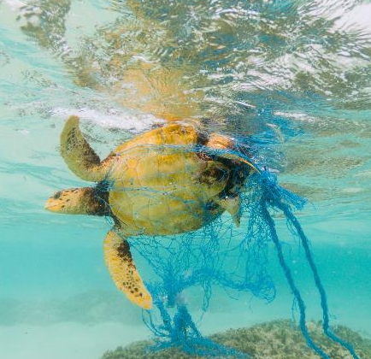

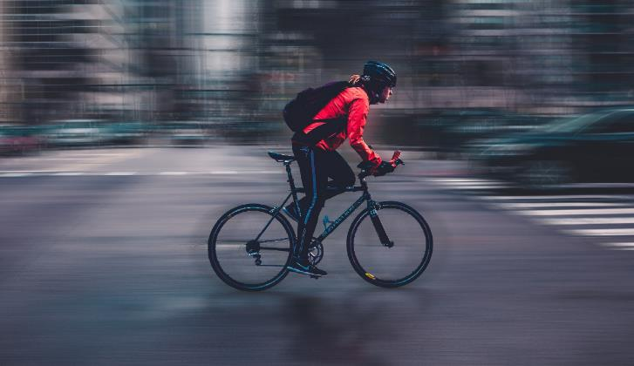
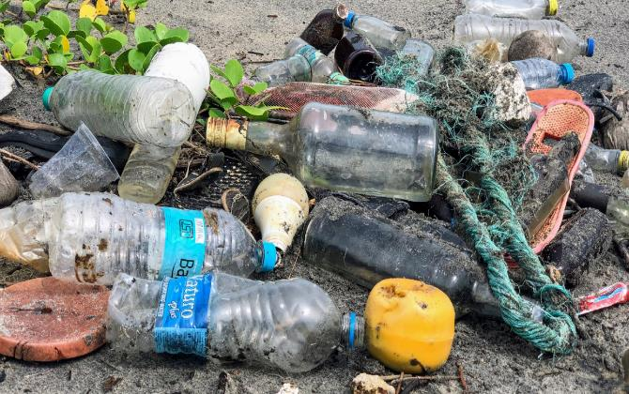




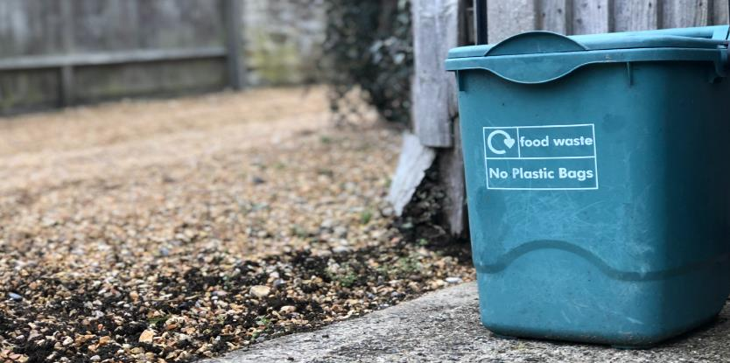
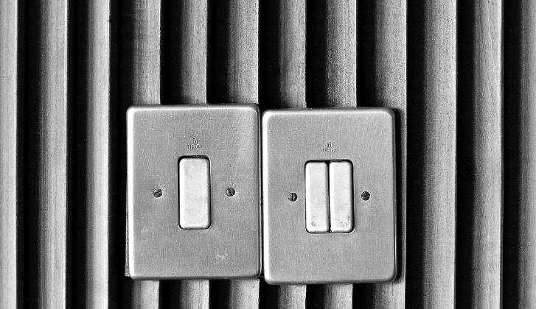

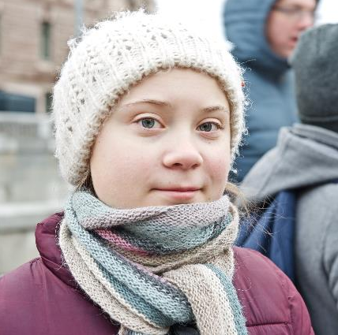
Notes:
Delivery notes
As a warm up activity, ask your pupils to suggest some answers to the questions on screen.
One of the images is of Greta Thunberg – she inspired the School Strike. She started protesting outside a government building in Sweden at age 15, saying that immediate action was needed to protect the environment. Soon after, she was speaking in front of world leaders. Her actions lead to the school protests that spread across the world in 2018-19.
In May 2019, over 1 million students in 1,400 cities around the world took to the streets to promote protecting the environment. The purpose of this march was to spread their message and get their voices heard.

Slide 7



To understand why recycling is important
To understand what can be recycled in your school, home and local area, and which bins to use
To understand why it’s important to take action and spread the word about recycling
I can…
…explain what recycling is, and why it is important
…use the recycling locator to check what can be recycled in your area
…help others to recycle by explaining what you have learnt
Notes:
Delivery notes:
Discussion - Learning aims and success criteria (2 minutes)
Run through the learning objectives and success criteria with your students.

Slide 8


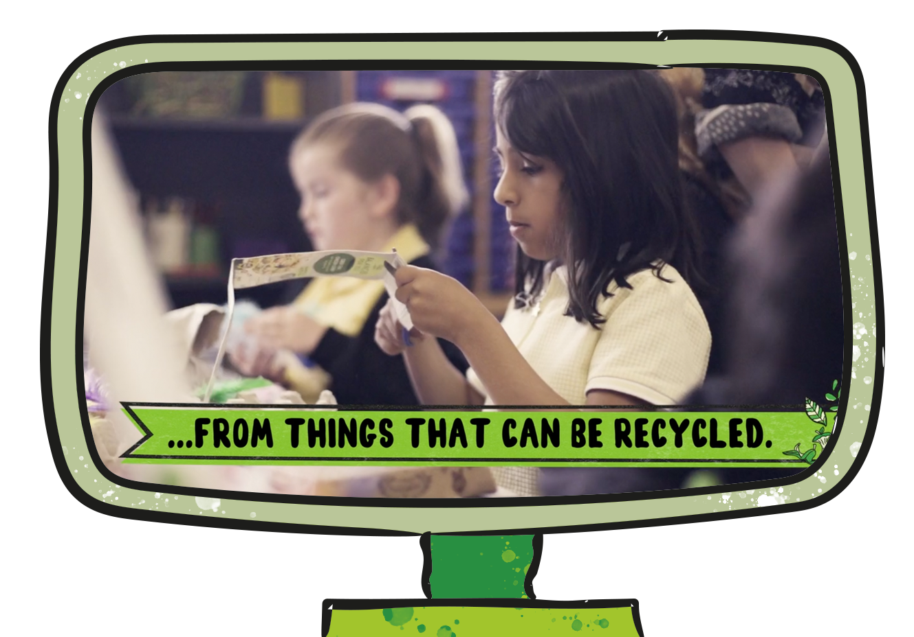

Notes:
Delivery notes:
Join the Action Pack film (5 minutes)
After playing the film to the class, discuss these questions in pairs or as a class:
How did this film make you feel?
What do you think is the message of this film? Does it have more than one message?
Does this film make you want to take action? Why?
Did this film teach you anything?

Slide 9
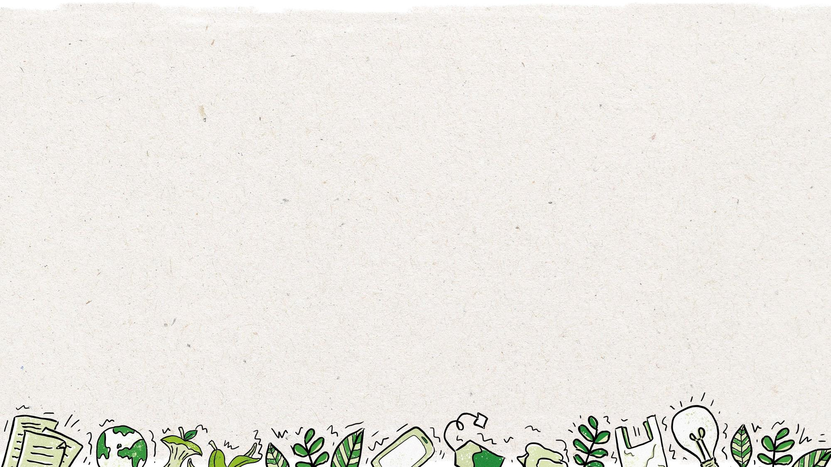





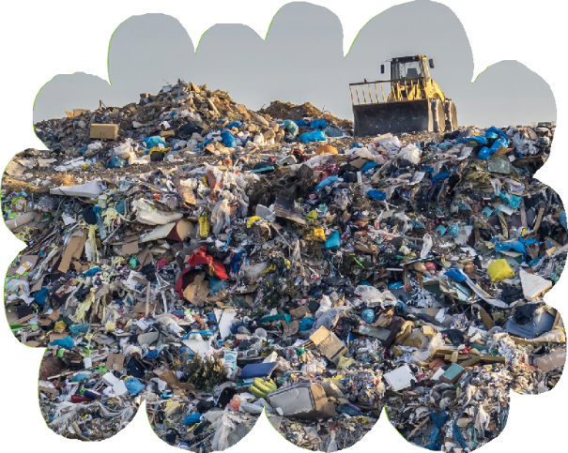
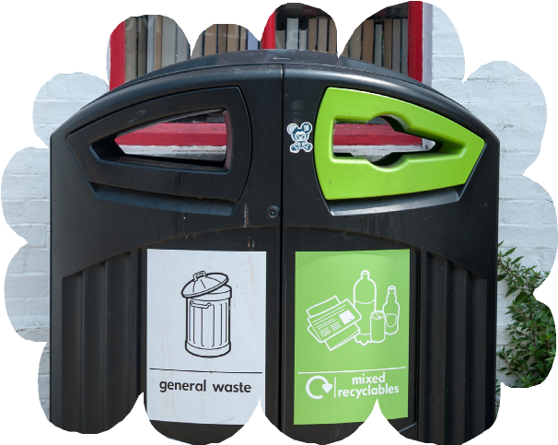
Notes:
Delivery notes:
Discussion – What happens to rubbish? (3 minutes)
Ask pupils:
Do pupils know what happens to rubbish when the bin lorry takes it away? Discuss the options as a class.
Click to display the first option ‘landfill’. Explain that rubbish that cannot be used again goes to landfill.
What is a landfill? Rubbish that is thrown away in normal bins gets take to landfills. Landfills are large holes where rubbish is dumped and buried.
Landfills are very bad for the environment. Rubbish in landfills slowly breaks down into harmful gases and chemicals. These gases and chemicals can pollute soil and add extra greenhouse gases into our atmosphere, leading to climate change.
By recycling, we reduce the amount of rubbish going into landfills, helping to protect the environment and reduce climate change.
Littering, or not getting rid of rubbish properly, can also harm animal habitats.
Click to display the second option ‘recycled’. Explain that rubbish that can be used again is recycled.
Rubbish should only be put in the bin and sent to landfill if it isn’t possible to reuse or recycle it.

Slide 10






Notes:
Delivery notes:
Discussion and sorting activity – What is recycling? (3 minutes)
Ask pupils:
What is recycling? Create a definition as a class, e.g. Recycling means to process something (like paper, glass or metal) so that it can be used again.
What are the alternatives to recycling our waste? Pupils may think about reducing what we use – not using it in the first place, reusing it, or disposing of it in landfill?
Click to display the blank triangle and the words Reduce, Reuse, Recycle and Dispose. Explain that we’re going to put the best option at the top, and the worst option at the bottom of the triangle.
What order should these words be placed in?
Click to display the hierarchy of waste, which shows how we should reduce waste and our impact on the environment:
Firstly, we should reduce our use of materials, especially common waste products like plastics. For example, we could take a re-usable water bottle out with us, so we don’t need to buy a single-use plastic bottle.
Secondly, we should reuse any materials that we can, for example by using newspapers as packing paper.
Finally, when we can no longer reuse an item or material, we should recycle it, so that it can be made into more products.
So you should only buy things you really need, and once you’re finished with them they should only be put in the bin and sent to landfill if it isn’t possible to reuse or recycle them.

Slide 11
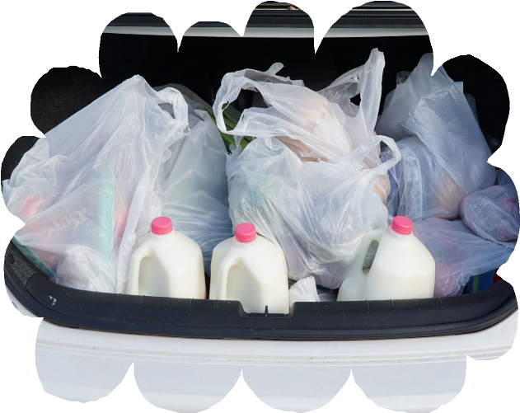
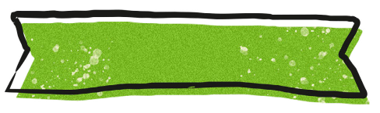


At the supermarket, Nikhil puts his shopping in plastic carrier bags. What should he do with the plastic carrier bags?
Notes:
Delivery notes:
Multiple-choice activity – At the supermarket (2 minutes)
Ask pupils the question on the slide.
For a more active approach, stick three signs on the walls of your classroom. Students move in the classroom and position themselves where they think is the correct answer. Alternatively, you could ask students to stand up, sit down or crouch down depending on what they think is the right answer.

Slide 12
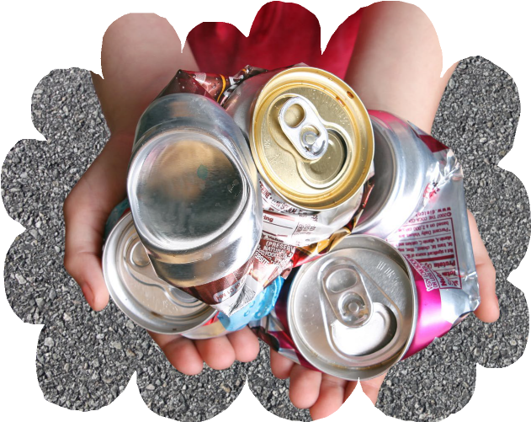
Carla has some empty drinks cans, what should she do with them?
Notes:
Delivery notes:
Multiple-choice activity – Drinks cans (2 minutes)
Ask pupils the question on the slide.
For a more active approach, stick three signs on the walls of your classroom. Students move in the classroom and position themselves where they think is the correct answer. Alternatively, you could ask students to stand up, sit down or crouch down depending on what they think is the right answer.

Slide 13



New things are made from the broken down pieces
Recycling is sorted into glass, paper, plastic or metal
Materials are broken down into small parts
Notes:
Delivery notes:
Discussion – How are items recycled? (3 minutes)
Ask pupils:
How are items recycled?
Recycling means using things that have already been used, to make new things.
Firstly, recyclable items must be sorted by material type; glass, paper, plastic or metal.
Then, the materials are broken down into smaller parts from which new items can be made.
For example, plastic bottles can be broken down into small pieces of plastic which can be used to make new items such as football shirts.

Slide 14






Notes:
Delivery notes
What materials can be recycled? (3 minutes)
Run through the categories on the slide.
Ask students to give examples of items from each category. For example:
Glass
Jam Jars
Bottles
Food
Egg Shells
Banana Skins
Paper
Magazines
Toilet Roll Tubes
Plastic
Shampoo Bottles
Yoghurt Pot
Metal
Aluminium Foil
Drinks Cans

Slide 15

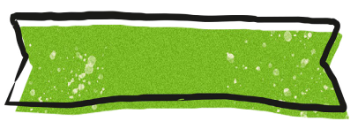
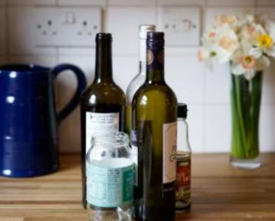
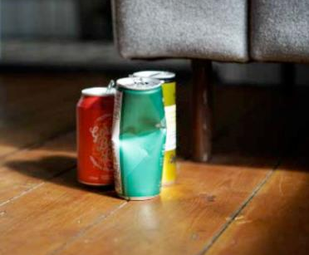
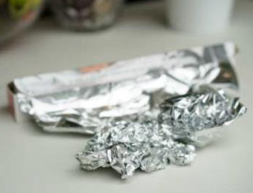
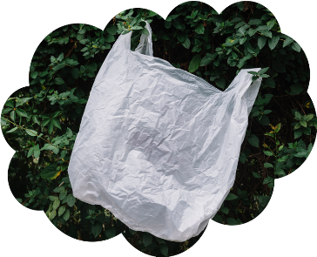
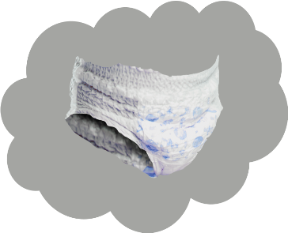
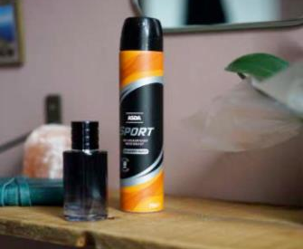
Notes:
Delivery notes
Sorting activity: What can we recycle? (5 minutes)
Go down the list of items and ask pupils to choose whether they can or can’t be recycled. Assign one side of the room as ‘Yes’ and the opposite side as ‘No’ and ask pupils to move to each wall to choose their answer. Alternative, pupils could raise their hand to indicate that they believe an item can be recycled.
Click the screen to make the statements move to the correct side of the screen one by one.

Slide 16

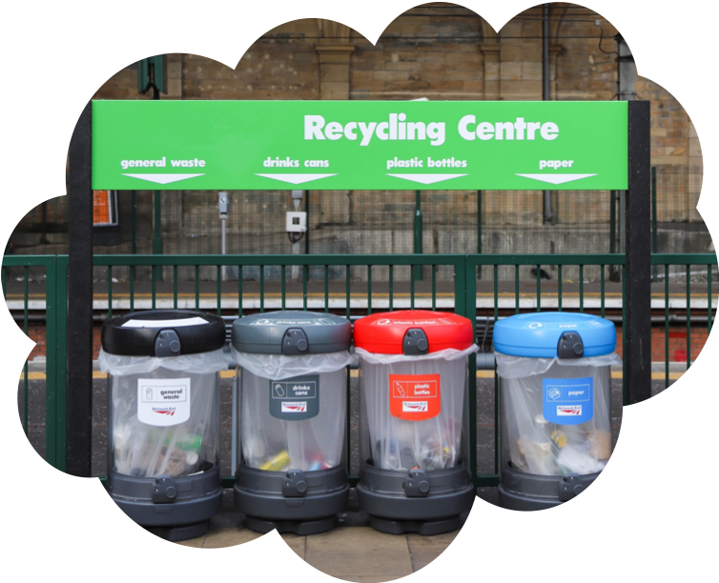

Notes:
Delivery notes
If time allows, replace these images with images of a recycling bins from your own home (or images from the Recycling Locator for your area) and school.
Discussion activity – Where do we recycle? (5 minutes)
Explain that different materials must be put into different types of recycling bin. These types of recycling bin differ by area.
Ask pupils:
What recycling containers do you have at home? What goes into them? Refer to the Home recycling survey, if you set this as a pre-task – what recycling containers do pupils have at home?
Where are the recycling bins in school? What do they look like? What goes in them?
Is there anywhere else that they can recycle in their area? (For example large recycling bins in supermarket carparks, or facilities at council recycling centres.)
Explain how important it is to know what can be recycled in your area and what bins to use, as this is the only way that you can recycle effectively.
EXTENSION ACTIVITY 1:
Sorting task (10 minutes)
Complete an in-class sorting activity using the information learned from using the Recycling Locator.
From a selection of recyclable and non-recyclable items. Ask the class to sort the items into two piles: items recyclable in your area and items not recyclable in your area.
Use Recycle Now’s recycling locator to check specific items. Pupils could take a photo at the end of the activity and display it in the classroom as a reminder of the materials that can/can’t be recycled in their area.
NB: For more activities and examples related to recycling bins, download the Recycling Take-home Activity Sheet from www.theactionpack.co.uk

Slide 17




Not recyclable
Sometimes not recyclable
Bubble wrap
Ceramics
Laminated paper
Wood
Mirrors
Shiny wrapping paper, foil paper or glittery paper
Paper with metallic, glitter or velvet on it
Toxic containers (items that could usually be recycled, like metal cans, can’t be recycled if they were used to hold toxic materials, such as paint)
Greasy containers (like toxic containers, recyclable items that have grease on them usually aren’t recyclable)
Stickers
Sellotape
Plastic toys
Nappies
Pet food pouches
Cat litter
Toothpaste tubes
Cotton wool
Tissues
Bricks
Envelopes with plastic windows aren’t always recyclable – so make sure to check if they can be recycled in your area using the Recycling Locator
Some wrapping materials aren’t recyclable – use the scrunch test to check
Only recyclable at special facilities
Plastic wrapping (sometimes called soft plastic) can often only be recycled at supermarkets. Check the recycling locator to see if this can be recycled in your local area.
Plastic bags (these can clog up recycling systems and shut down recycling plants for hours! Instead, recycle plastic bags separately – there are usually special bins at supermarkets)
Electronic items (these can be recycled, but they usually need to be recycled separately at a recycling centre or special kerbside recycling bins)
Notes:
Delivery notes
What can’t be recycled (2 minutes)
Run through the list so that pupils understand what is not recyclable. This slide can also be printed out and used as a reference in the classroom, around the school or in pupils’ homes.

Slide 18




If you see any of these symbols on an item, it means it can be recycled, but you should always check your local area.
Notes:
Delivery notes
Symbol identification activity: How do you know if something can be recycled? (5 minutes)
Reinforce that not all materials, or types of a material (e.g. types of plastic) can be recycled. Ask pupils:
How do you know if something can be recycled? Explain that many materials have symbols to give you information about recycling.
On screen are a number of recycling-related symbols. Ask pupils:
Do they recognise any of the symbols? What do they mean?
Check out Recycle Now’s comprehensive guide to recycling symbols here: www.recyclenow.com/recycling-knowledge/packaging-symbols-explained

Slide 19

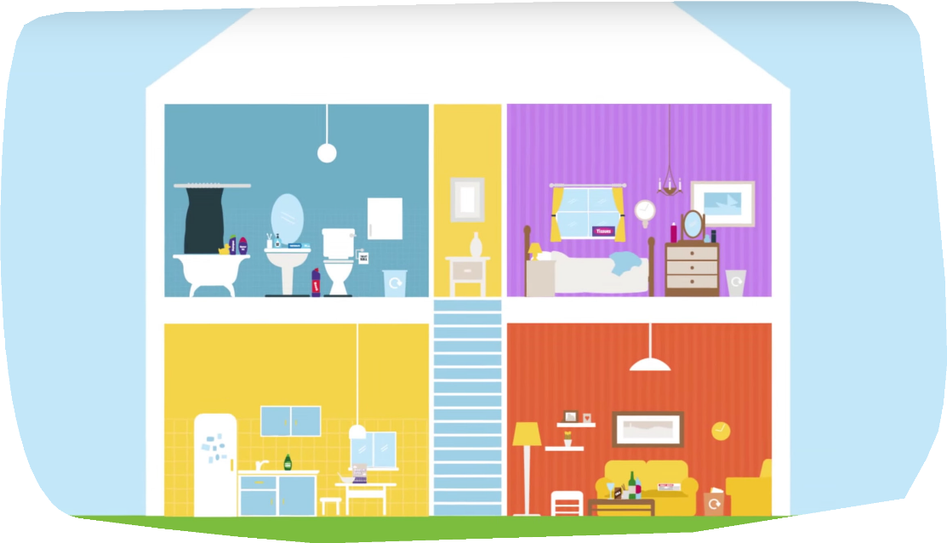
Notes:
Delivery notes
TAKE-HOME ACTIVITY - Find things that can be recycled at home
Ask pupils to think about the different materials that can be recycled in each room of their house.
Play this video to give pupils an idea of what items can be recycled from each room: www.youtube.com/watch?v=sLktjtlXCNo
Encourage pupils to think of more recyclable items that are in different rooms in their own homes.
For activities and examples related to room-by-room recycling, complete or send home the Recycling Take-home Activity Sheet (Reception / Years 1&2), which can be downloaded from www.theactionpack.co.uk
Then, they can tell their family about all the things they’ve learnt today!

Slide 20
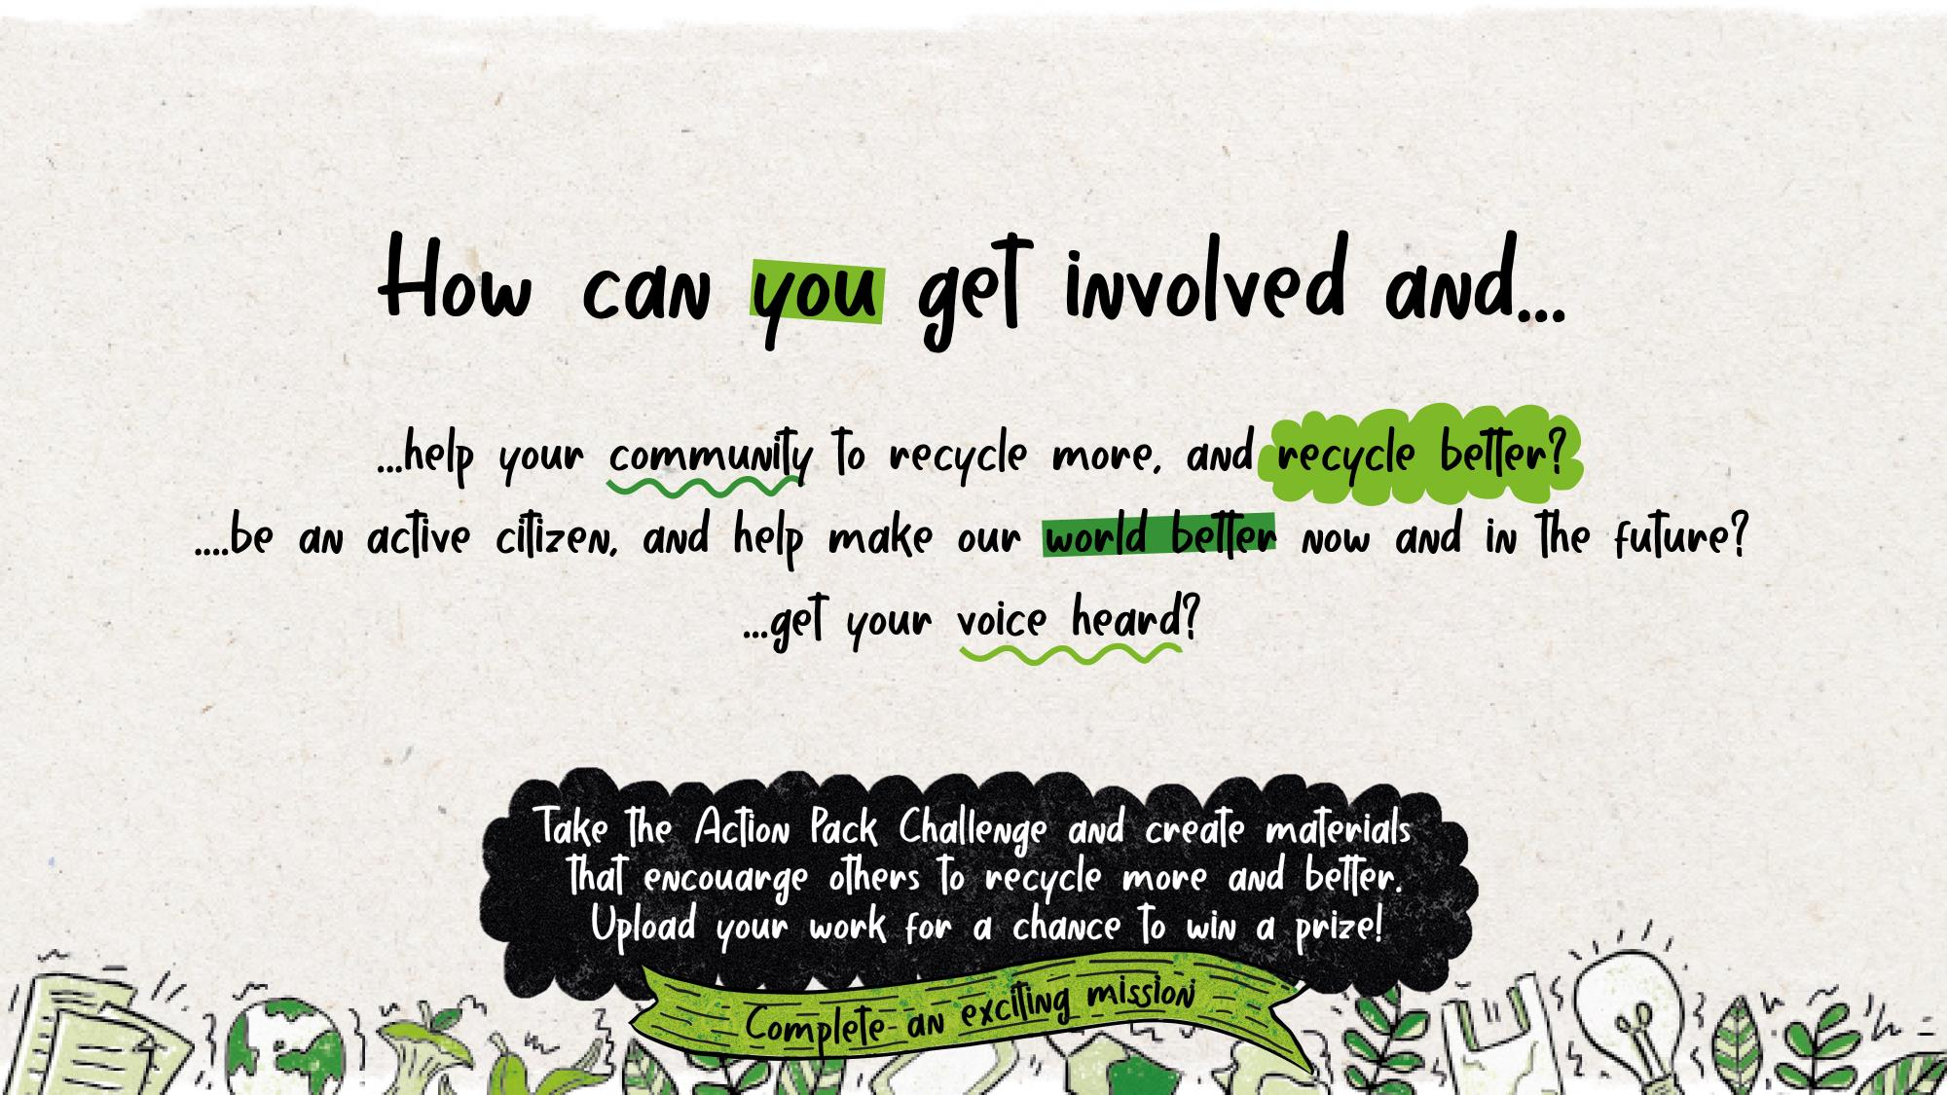
Notes:
Delivery notes
Discussion – Getting involved, making a difference (3 minutes)
Explain that the Action Pack is all about taking action and making positive changes! It’s not enough to simply learn about recycling, you need to use what you’ve learnt to make a difference!
Explain the three steps to taking action:
Using the information you’ve learnt to make positive changes in your own life and recycling as much as possible
Spreading the information you’ve learnt to other people in your life, such as your family, by talking to them about recycling and putting up the recycling posters you made around your house
Taking part in the Action Pack Recycling Challenge.
Plenary (2 minutes)
Before finishing the lesson, go over the learning aims with the class. Tell them to hold up fingers to show how well they think they completed each aim.
One finger = I don’t understand
Five fingers = I understand entirely
Learning aims:
To understand why recycling is important
To understand what can be recycled in your school, home and local area
To understand why it’s important to take action and spread the word about recycling
Use the same method to check whether pupils have completed all of the success criteria.
Success criteria:
Be able to explain what recycling is, and why it is important
Be confident using the recycling locator to check what can be recycled in different areas
To create recycling posters for your home and putting them up in places where they will be seen

Slide 21
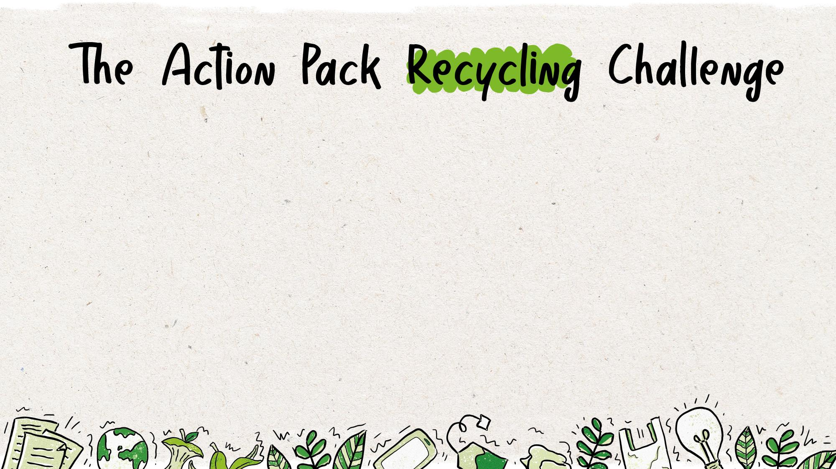
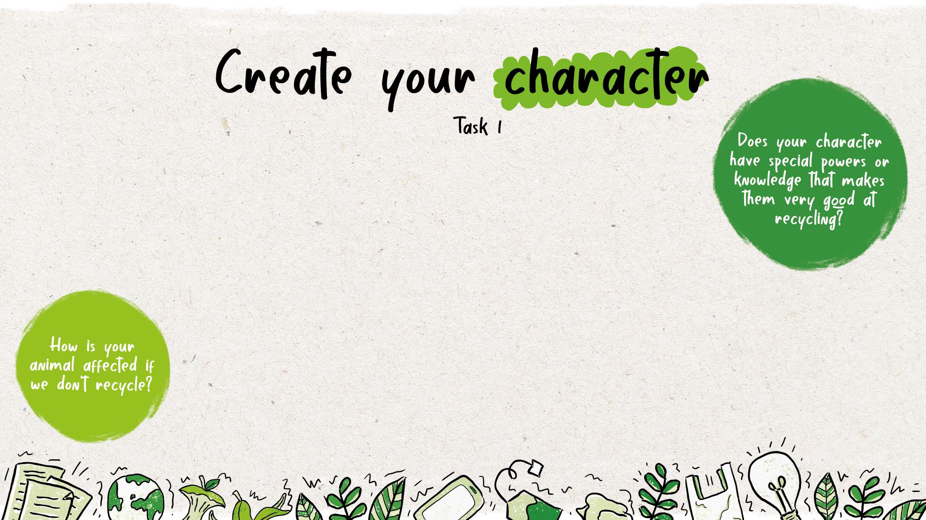
Your mission: Create a poster to help others in your family to recycle more, and recycle better. Your poster must have:
a memorable animal character (this can be any animal, from the sea, land, or sky!) who is passionate about recycling
an inspiring message that will help others recycle more and recycle better
Pupils can use and adapt these messages as they like:
Recycle plastic bags at the supermarket.
Don’t forget to recycle items from the bathroom.
Crush plastic bottles before recycling them.
Make sure to recycle aluminium foil.
Use the Recycling Locator to help you recycle better!
Notes:
Delivery notes
Introduction: The Action Pack Recycling Challenge (3 minutes)
Run through the information on the slide.
Share Your Work
Share your pupils work with the school and wider community – the Action Pack’s Eco Shows.
Share your work through:
Putting it on school noticeboards where parents will see it
The school website
Classroom windows
The local press
School social media channels
The school newsletter
Displayed at a parents evening
The local council
Parents’ WhatsApp group
And with us for a chance to win a prize!
For more information and full terms and conditions please see: www.theactionpack.co.uk/submit-your-work

Slide 22
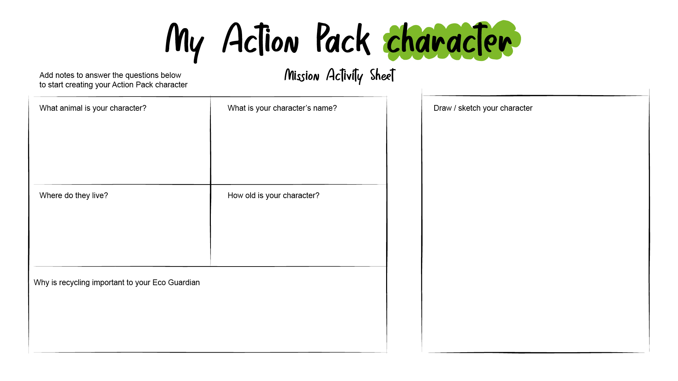
Notes:
Optional extension (10-20 minutes) – Print this slide for students to complete
Ask pupils (working independently or with a partner) to use the My Action Pack Character activity sheet (slide 12) to think about their character’s traits.
Once pupils have had time to complete their activity sheet/discuss their characters select a couple of pupils to present their ideas.
Why have you chosen that animal?
What is your character’s most important character trait?
Why does your character want more people to recycle?

