Slide 2
Create a poster to help others in your community to recycle more, and recycle better.
Curriculum links: PSHE, Art, English
Time required: 1 hour

Slide 3
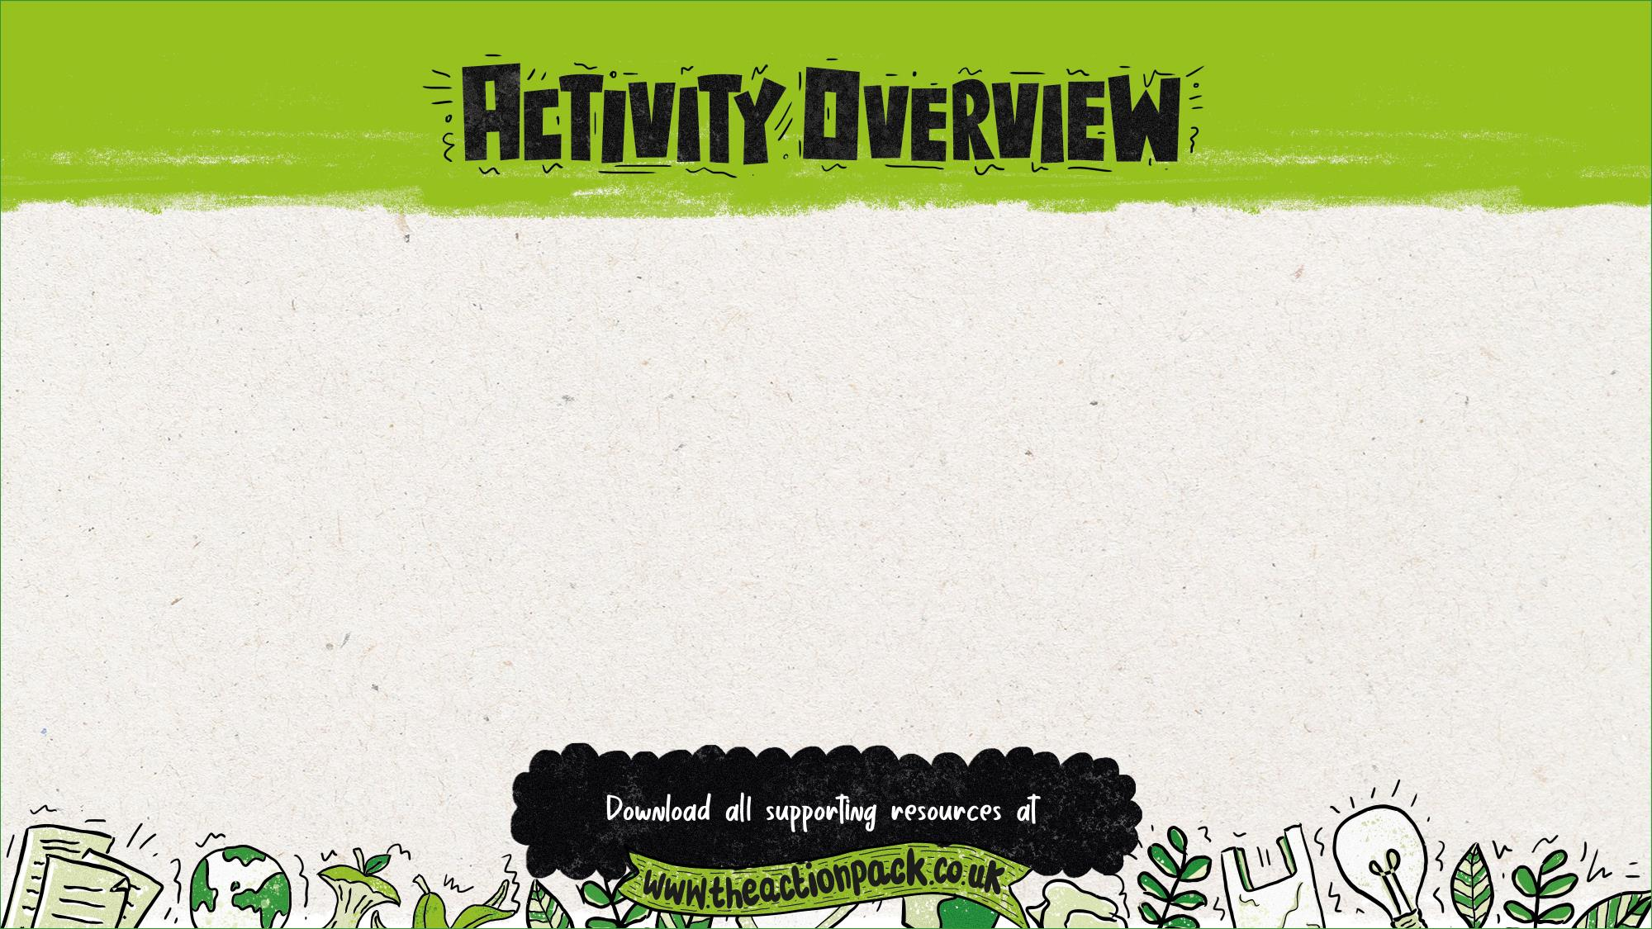
This presentation guides pupils through creating a poster featuring an animal character that persuades their families and others in their community to recycle more, and better. Send photos of their posters to www.actionpack.co.uk for a chance to win a prize!
Where to use this activity
This activity can be completed:
in class
as homework
at breakfast or after-school clubs
with an eco committee or school council
in an out-of-school club.
How to use this presentation
The teachers’ notes slides at the start of this presentation are hidden, so they won’t appear in presentation mode.
There is additional information for teachers in the slide notes for each of the pupil slides (6-20).
How to use this activity
Depending on options chosen, this activity could be run over one or two 60 minute sessions, or elements omitted to suit your pupils and the timings of the school day. See the next slide for details on these options.
Preparation
The activities in this presentation assume a good baseline knowledge of recycling from pupils. For a comprehensive introduction to recycling check out lesson one, Join the Action Pack.
Follow up
Optional: Create a film to encourage your community to recycle more of the right things more often, using the Lights, Camera, Action Pack! presentation.

Slide 4
Why use this activity?
This lesson was created in partnership with teachers to make sure that it links to the curriculum and enhances learning.
The lesson helps to inform, inspire and empower children to get their voice heard and bring about change.
It also encourages pupils to become active citizens who make a positive contribution to society, helping to fulfil the requirements of Ofsted and promote British values.
This PowerPoint could form part of your audit and action plan for the UNICEF Rights Respecting Schools Award, or as part of your Eco-Schools Award action plan.
It includes flexible resources that can be used with small groups, a whole class, the entire school or the School Council.
Use this lesson to get people in your local area recycling more, helping to conserve our planet’s precious resources.
By submitting the work your pupils produce in this lesson, you’ll be in with a chance to win great prizes.
Who produced this activity?
Recycle Now is an established brand that campaigns to encourage and motivate citizens to recycle more things, more often, from all around the home. We use our evidence, interventions and ground-breaking behaviour change theory to motivate citizens to recycle.
For more information about Recycle Now visit: www.recyclenow.com
You can also help to encourage recycling by adding the Recycling Locator to your website – email: partnerenquiries@wrap.org.uk

Slide 5
PSHE Association Programme of Study, England
Core Theme 3: Living in the wider world
KS2
L1. to research, discuss and debate topical issues, problems and events that are of concern to them and offer their recommendations to appropriate people
L7. that they have different kinds of responsibilities, rights and duties at home, at school, in the community and towards the environment; to continue to develop the skills to exercise these responsibilities
L10. to recognise the role of voluntary, community and pressure groups, especially in relation to health and wellbeing
L15. that resources can be allocated in different ways and that these economic choices affect individuals, communities and the sustainability of the environment across the world
Northern Ireland, Key Stage 2
The World Around Us
pupils should be enabled to explore how waste can be reduced, reused or recycled and how this can be beneficial.
Science, Year 4
Living things and their habitats
recognise that environments can change and that this can sometimes pose dangers to living things.
(Pupils should explore examples of human impact (both positive and negative) on environments, for example, the positive effects of nature reserves, ecologically planned parks, or garden ponds, and the negative effects of population and development, litter or deforestation)
Ofsted School inspection handbook
'Pupils' spiritual, moral, social and cultural development (SMSC) equips them to be thoughtful, caring and active citizens in school and in wider society.’
Promoting fundamental British values as part of SMSC in schools
'Through their provision of SMSC, schools should… encourage students to accept responsibility for their behaviour, show initiative, and to understand how they can contribute positively to the lives of those living and working in the locality of the school and to society more widely.’
Unicef Level 1 Rights Respecting Schools Award
'Children and young people are beginning to see themselves as rights respecting global citizens and advocates for fairness and children’s rights locally and globally.’

Slide 6
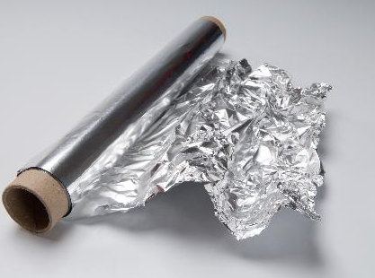
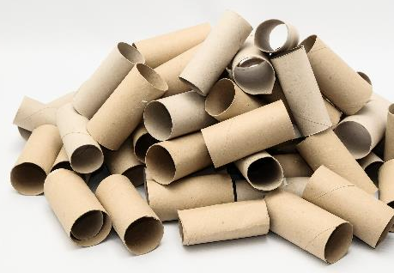
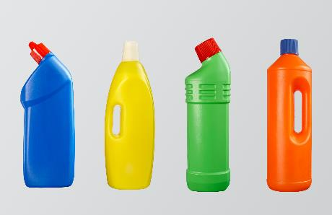
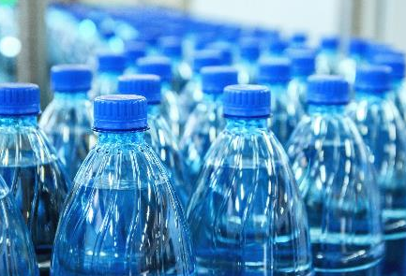
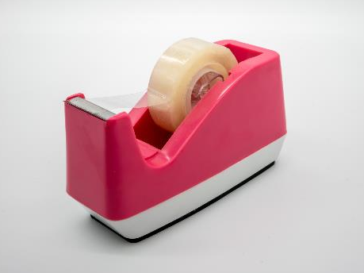
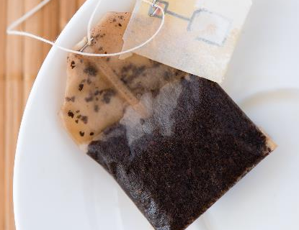
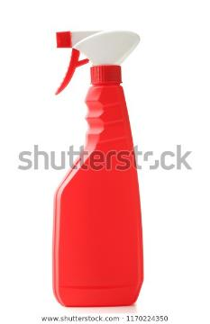
Notes:
Delivery notes
Optional starter: Can these items be recycled? (5 minutes)
Review/refresh pupils’ knowledge of recycling with this optional active starter.
Feel free to swap images to review particular examples if you have identified any common misconceptions in your class during the Join the Action Pack lesson.
Click to reveal the items one by one.
Ask pupils to stand up and put their arms in the air/stretch as high as the can if the item can be recycled and stay sitting down/squat down if it cannot. If an item should go in the food waste bin ask pupils to put their hands on their head.
Answers:
Plastic bottles – yes, widely recycled
Aluminium Foil – yes, widely recycled
Sellotape – not recyclable
Cardboard loo roll – recyclable
Glass jar – recyclable
Plastic cling film – not widely recycled at home (although is accepted at carrier bag collection points)
Tea bags – compostable/food waste
Paper (coffee) cups – not widely recyclable. The plastic coating inside the cup is very hard to separate from the paper cup itself, which makes it harder to recycle than plastic or paper.

Slide 7
Your mission: Create a poster to help others recycle more, and recycle better.
Task 1: Create a memorable animal character to feature on your poster
Task 2: Think about your audience and choose an inspiring message that will really make a difference to their behaviour
Task 3: Share your work on the Action Pack website!
Notes:
Delivery notes
Introduction: The Action Pack Recycling Challenge (3 minutes)
Run through the information on the slide.

Slide 8
Your first Action Pack task is to create your own character to inspire others to recycle
Remember, your character should be:
an animal or creature (this can be any animal, from the sea, land, or sky!)
memorable – what will make your character stand out to people who see your poster? What makes them different from other characters?
passionate about recycling and ready to inspire others to recycle more and better!
Notes:
Delivery notes
Create your character (3 minutes)
Run through the information on the slide.
Please note: We suggest pupils’ characters should be an animal to reinforce the impact recycling can have on the natural world. However, we do encourage creativity, so entries that are mystical creatures/original creations are also allowed as long as they inspire others to recycle more and better!
Optional extension (10-20 minutes)
Ask pupils (working independently or with a partner) to use the My Action Pack Character activity sheet (slide 12) to think about their character’s traits.
Once pupils have had time to complete their activity sheet/discuss their characters select a couple of pupils to present their ideas.
Why have you chosen that animal?
What is your character’s most important character trait?
Why does your character want more people to recycle?
Support: highlight the My character activity sheet word bank to help pupils design their character.
Challenge: when selecting key words to describe their characters, ask pupils to consider what characteristics they think are important for a character who wants to persuade others to recycle? (E.g. brave and outspoken to spread the word, helpful to inform and support others, or friendly and happy to help persuade?)
Use the example animals on the Personification activity sheet (Slide 13) to start pupils thinking about the animal they could create and personify to be their character. Discuss with the class:
Why have you chosen that animal/creature? (e.g. a whale lives in the sea, which is where a lot of rubbish goes if we don’t recycle!)
What characteristics do you think that animal might have? (Make clear there are no right or wrong answers!)
Ask pupils to think of further animals they could create – e.g. what animals do they think would be most affected if people don’t recycle?

Slide 9
Your second Action Pack task is to think about your audience and decide on a message for your poster
Audience
Think about:
Who is your main audience?
What is most important for them to know?
Message
Your message should:
inform others about what can be recycled in your area
inspire your audience to recycle more, and recycle better
be clear – don’t try to say too much at once
include some interesting statistics and facts
Notes:
Delivery notes
Think about your audience (5 minutes)
Encourage pupils to think about their audience (e.g. their families) and recycling:
What do they do well already?
What don’t they do so well?
What might they not know?
If pupils have completed the Home recycling survey:
What did people find difficult about recycling?
What would make it easier?
What questions do people they have?
Audience - Optional extension: (15 minutes)
If time permits, run discussions as an active brainstorm.
Work through the questions one by one taking suggestions at the front and adding them to three large A3/A2 pieces of paper.
Divide the pieces of paper around the room
Ask pupils to move around the room and write down as many answers as possible to each question in 1 minutes (divide into two groups if a large class, or give each pupils a stack of post its)
Repeat the activity, but ask pupils to now think specifically about particular audiences/groups of people such as: older people (e.g. grandparents), parents/guardians, older brothers/sisters, teachers, neighbours (if possible use different colour pens/post its for each group)
Once finished give pupils two minutes to walk around and read what other pupils have written and add a tick next to ideas/questions they think are the most important
Collect in the sheets and share the most ticked ideas/questions with the class
Ask pupils to discuss these ideas with a partner – how could they answer these questions/use these ideas in their poster? Select pairs to feedback their initial ideas.
Think about your message (5 minutes)
Show the posters on the The Action Pack in action slide (slide 19), and the sample messages on the Messages bank slide (slide 14).
They could use or adapt one of the sample messages.
Run through the information on the slide about what creates a good message.
Pupils may wish to incorporate some of the stats on the Recycling Fact File slides (slides 15 to 18).
Nudge theory: this theory of behaviour change focuses on creating small ‘nudges’ or opportunities for people to change their behaviour. Other examples include an American Grocery store which placed green arrows on the floor of its shops leading to the grocery isles, a simple addition led to huge increases in vegetable sales, or Amsterdam Airport where small fly stickers were added to urinals, having something to aim for (if only subconsciously) reduced ‘spillages’ by 80%!

Slide 10
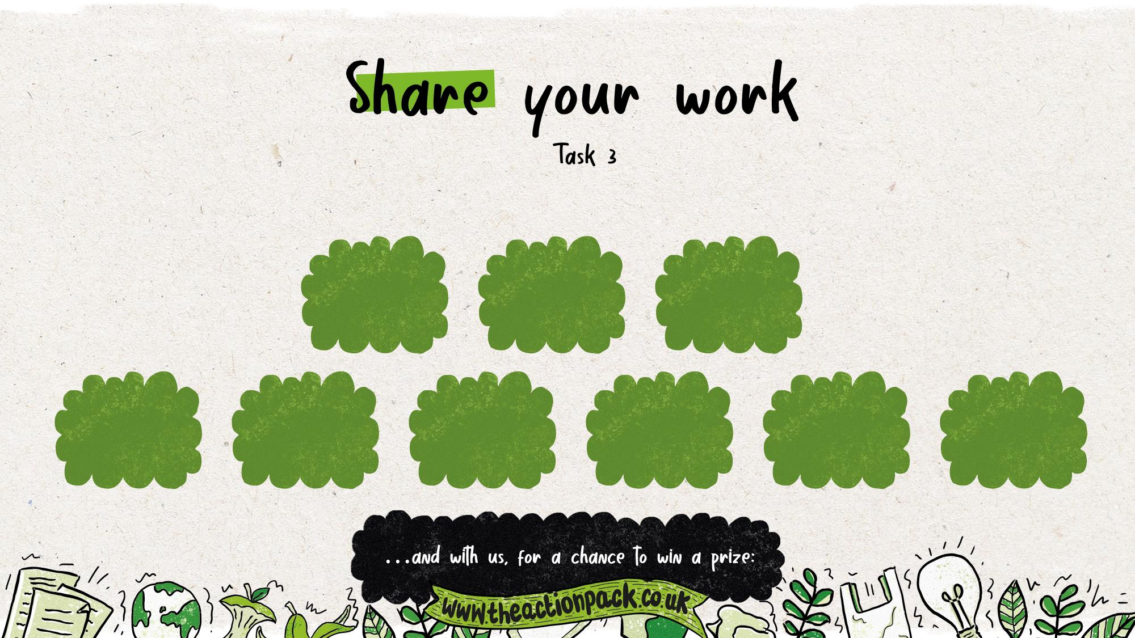
Share your work through…
putting it on school noticeboards where parents will see it
the school website
classroom windows
the local press
school social media channels
the school newsletter
displayed at a parents’ evening
the local council
parents’ WhatsApp group
Notes:
Delivery notes
Share your pupils work with the school and wider community – the Action Pack’s Eco Shows.
Post your film links on class WhatsApp groups or school social media channels
Put the film links in the school newsletter. Kids could take over the school newsletter, featuring their film and other work around recycling or eco topics.
Invite parents in to school to watch your show live.
Share your research findings with your parents so they know what not to buy!
Send your films to the local council or local press.
And share your films with us to be in with a chance of winning a prize!
For more information and full terms and conditions please see: www.theactionpack.co.uk/submit-your-work

Slide 12
Add notes to answer the questions below to start creating your Action Pack character
What animal will inspire your character?
What is your character’s name?
Draw/sketch your character.
Where do they live?
How old is your character?
What is your character like? Pick three words to describe their personality.
What does your character like to do? Name two activities.
Why is recycling important to your Eco Guardian? Write three reasons
Word bank Places - setting
sea * ocean * forest * garden * nest * mountain * recycling bin * shed * city * hill * nest * wood
Verbs - doing words
walk * run * smile * play * recycle * sort * rinse * clean * help * swim * fly * laugh * sing *
Adjectives - describing personality
loud * quiet * shy * outgoing * energetic * lazy * happy * sad * outspoken * clever * brave * friendly * funny * caring * sensible * cool * calm * adventures * awkward * patient * helpful

Slide 13
Which animal might be…
loud * proud * quiet * shy * outgoing * energetic * happy * outspoken * clever * brave * busy * helpful

Slide 14
Pupils can use and adapt these messages as they like:
Recycle plastic bags at the supermarket.
Put recycling bins in every room of the house.
Remember to recycle items from the bathroom.
Squash plastic bottles and replace the lids before recycling them.
Recycle batteries using the bin at school.
Learn the different recycling symbols.
Make sure to recycle aluminium foil.
Use the Recycling Locator to help you recycle better!

Slide 15
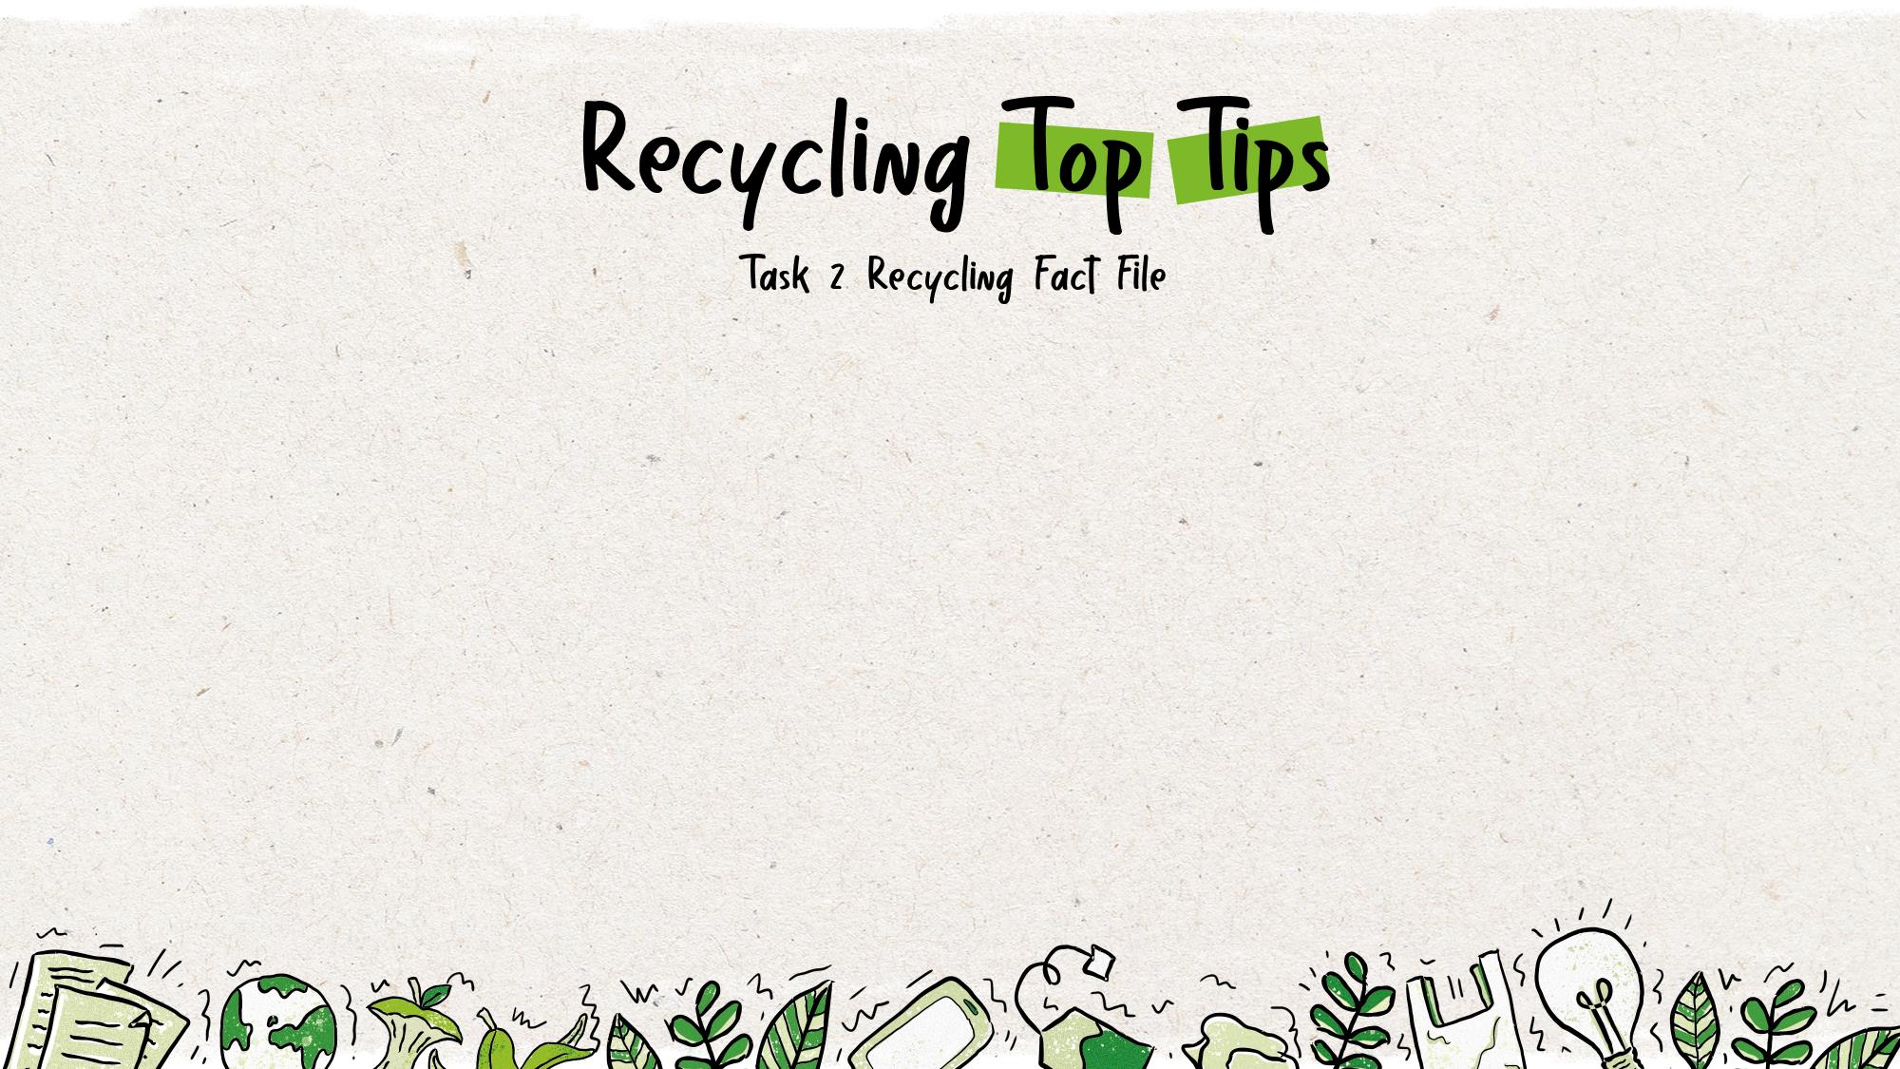
Look around your home and find all the items which can be recycled from your bathroom, bedroom or lounge.
Simply empty, rinse, squash, and put any lids back on before putting them in the recycling bin!
Keep a recycling bin, bag or basket in the bathroom to recycle bathroom waste.
Plastic bags usually cannot be recycled in normal recycling bins – you need to put them in special bins found in large supermarkets.
Notes:
Delivery notes
After completing the room-by-room recycling list activity, show this slide to give pupils some extra Recycling Top Tips. They should add the tips to the bottom of their lists for each room. The corresponding rooms are listed below.
Items should be cleaned of food – Kitchen
Empty, rinse, squash and put lids back on before recycling – Kitchen or Bathroom
Keep a separate recycling bin or bag in the bathroom – Bathroom
Plastic bags usually cannot be recycled – Kitchen
Plastic toys can’t be recycled – Bedroom
Wet wipes, cotton wool, tissues and nappies can’t be recycled – Bedroom/Bathroom
Toothpaste tubes and mirrors also can’t be recycled – Bathroom
Keep a container under you kitchen sink – Kitchen
Junk modelling - Bedroom
Make sure all pupils include in their posters something about why recycling properly is so important.

Slide 16
Plastic toys can’t be recycled – but they can be given to charity!
Wet wipes, cotton wool, tissues and nappies cannot be recycled.
Putting non-recyclable items in a recycling bin might mean your bin doesn’t get collected. If it does get collected, all the recycling from your area might be thrown away instead of recycled. So it’s important to recycle properly!
Put any food scraps in your food recycling bin (if you have one), rinse the packaging and recycle it as normal.
Aerosols can usually be recycled. Check the recycling locator to see if you can recycle these at home.
Notes:
Delivery notes
After completing the room-by-room recycling list activity, show this slide to give pupils some extra Recycling Top Tips. They should add the tips to the bottom of their lists for each room. The corresponding rooms are listed below.
Items should be cleaned of food – Kitchen
Empty, rinse, squash and put lids back on before recycling – Kitchen or Bathroom
Keep a separate recycling bin or bag in the bathroom – Bathroom
Plastic bags usually cannot be recycled – Kitchen
Plastic toys can’t be recycled – Bedroom
Wet wipes, cotton wool, tissues and nappies can’t be recycled – Bedroom/Bathroom
Toothpaste tubes and mirrors also can’t be recycled – Bathroom
Keep a container under you kitchen sink – Kitchen
Remove all stickers from items – Bedroom
Junk modelling - Bedroom
Make sure all pupils include in their posters something about why recycling properly is so important.

Slide 17
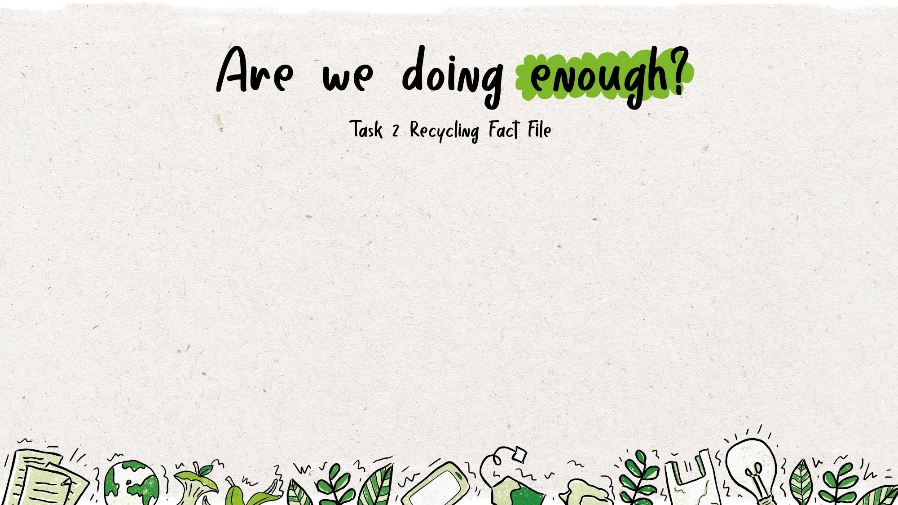
In the UK, we recycle roughly ___% of our household waste.
Every house in the UK throws away over _____ kilograms of waste each year on average.
70
It takes ___% less energy to make a newspaper from recycled materials, rather than new.
The UK recycles about ___% of its cans. Countries like Brazil recycle nearly 100% of their cans.
75
45
1,000
Notes:
Delivery notes
Ask pupils to suggest reasons why it’s important to recycle, and recycle properly, based on what they’ve learnt in the lesson so far.
Knowing that recycling is so important, do they think that we are doing enough to recycle properly in the UK? Do they think they could do more to recycle properly? Could the country as a whole be doing more?
Explain that they’re going to try to guess some facts about recycling in the UK. Choose three locations around the classroom and name them A, B and C. Pupils have to go to one of these locations to make their choice about each recycling fact.
Go through each question one by one, giving students the three possible answers to each one. After each question, reveal the answer by clicking the screen.
A) 45% B) 70% C) 90%
A) 100 B) 500 C) 1,000
A) 30% B) 50% C) 70%
A) 55% B) 75% C) 95%
A) 100 B) 1,000 C) 1,000,000
A) 450 B) 45 C) 5
A) 38,500,000 B) 38,500 C) 3,850
A) 15,000 B) 150,000 C) 15,000,000
At the end, ask the pupils:
If anyone got all the answers correct?
Were there any answers that surprised them? Why?
Do they think that the UK is doing enough to recycle its waste? Why? Why not?

Slide 18
1,000,000
In the UK we use roughly _________ plastic bottles a day, of which _________ are not recycled.
Over __________ tonnes of paper and card was not captured for recycling in 2017.
Plastic bottles that end up in the ocean take ____ years to fully break down.
38,500,000
450
15,000,000
Notes:
Delivery notes
Ask pupils to suggest reasons why it’s important to recycle, and recycle properly, based on what they’ve learnt in the lesson so far.
Knowing that recycling is so important, do they think that we are doing enough to recycle properly in the UK? Do they think they could do more to recycle properly? Could the country as a whole be doing more?
Explain that they’re going to try to guess some facts about recycling in the UK. Choose three locations around the classroom and name them A, B and C. Pupils have to go to one of these locations to make their choice about each recycling fact.
Go through each question one by one, giving students the three possible answers to each one. After each question, reveal the answer by clicking the screen.
A) 45% B) 70% C) 90%
A) 100 B) 500 C) 1,000
A) 30% B) 50% C) 70%
A) 55% B) 75% C) 95%
A) 100 B) 1,000 C) 1,000,000
A) 450 B) 45 C) 5
A) 38,500,000 B) 38,500 C) 3,850
A) 15,000 B) 150,000 C) 15,000,000
At the end, ask the pupils:
If anyone got all the answers correct?
Were there any answers that surprised them? Why?
Do they think that the UK is doing enough to recycle its waste? Why? Why not?

Slide 19
Notes:
Delivery notes
Here are some examples of completed missions.
Use these images to help inspire your students to take action.

